Slide 1
Symbolic Music and AI
A tiny overview of methods for processing and generating symbolic music data
Maximos Kaliakatsos-Papakostas, PhD
maximoskalpap@gmail.com

Slide 2
Symbolic Music Processing
Part 1/3
What can data tell us about qualities of music?

Slide 3
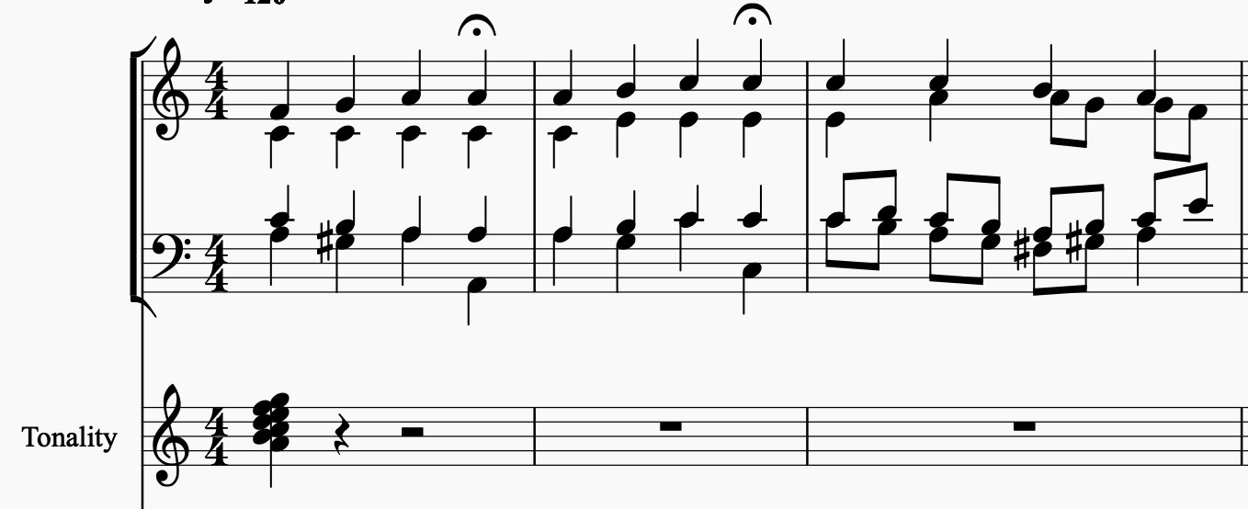
Musical surface to data
There are many depending on what we cant to capture: pitch classes, onsets or durations (rhythm), polyphony and range (texture)…
One way to go with it, if we are only interested in pitch classes:

Slide 4
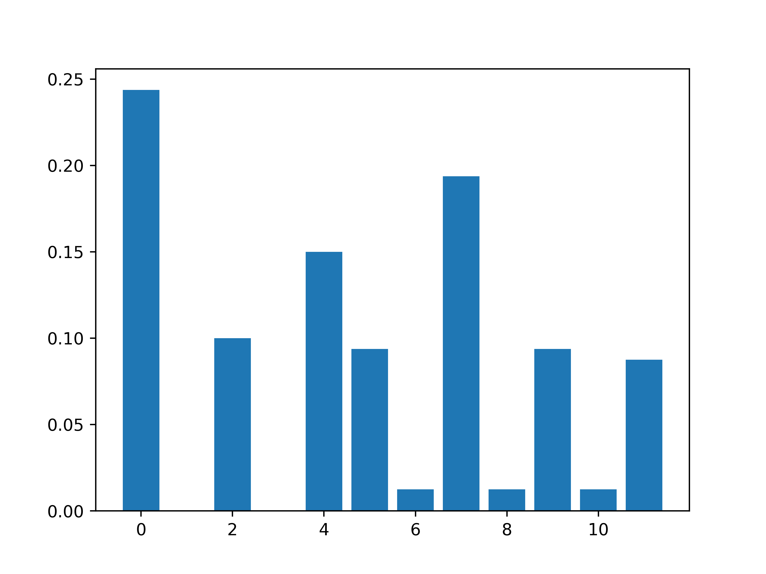
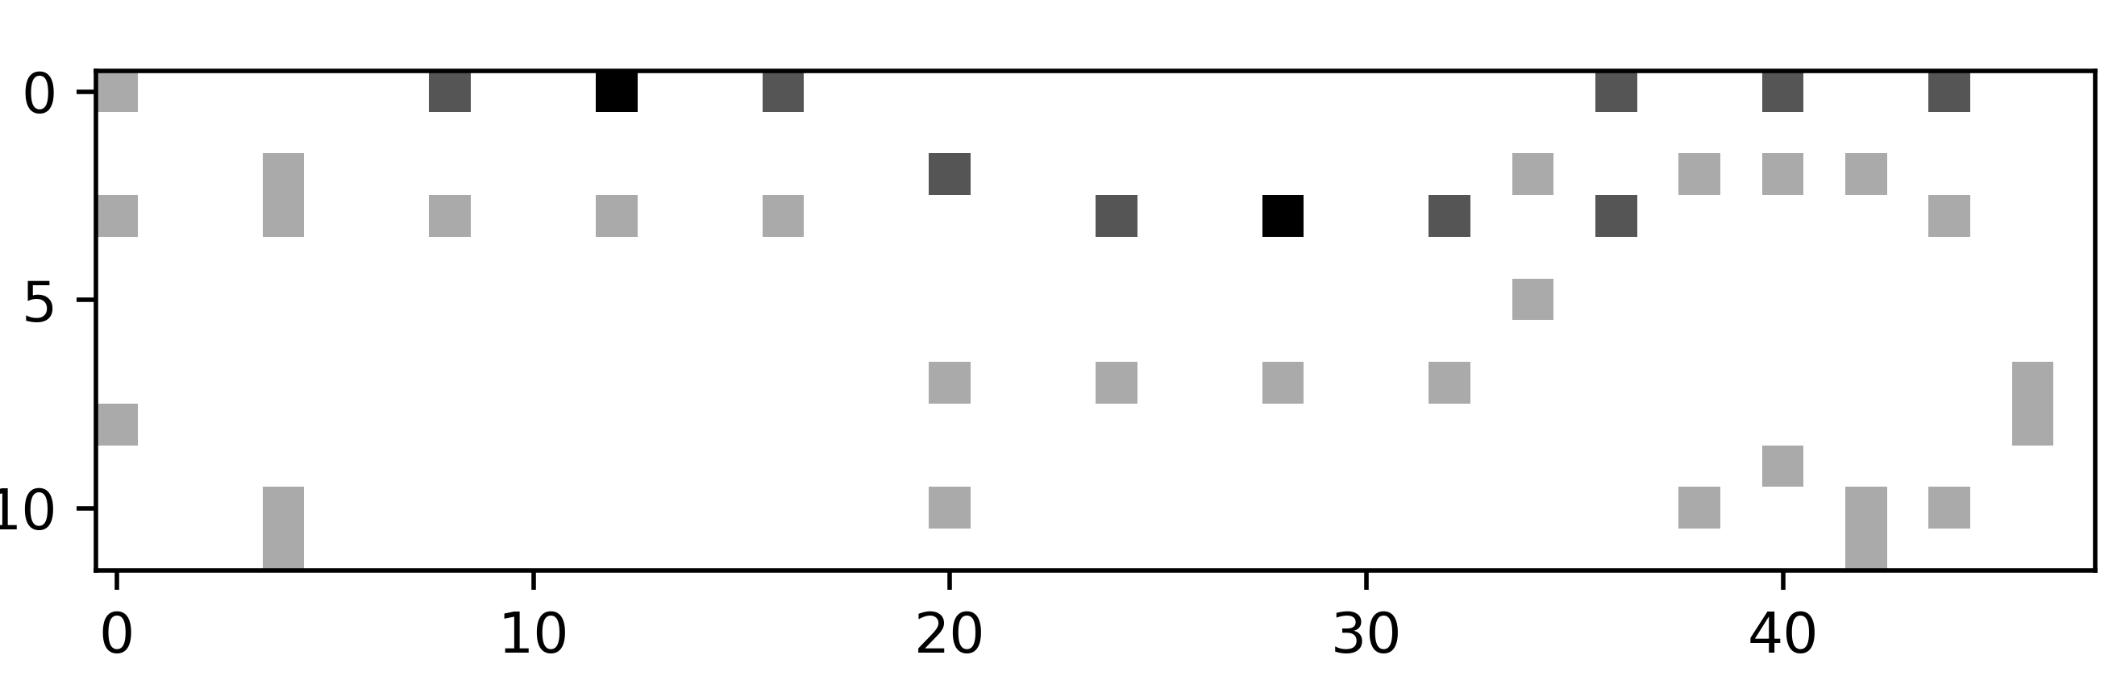
One way to go with it, if we are only interested in pitch classes:
Extraction of relative
pitch classes
Extraction of relative pitch class profile (rPCP)

Slide 5
Principal Component Analysis (PCA)
Consider a collection of many pieces (Bach chorales and Jazz standards)
We want to get an vague idea about harmonic characteristics in this dataset
A good idea is to visualize all the data in a single plot
Let’s use rPCP!
From the 12-dimensional space of rPCP we can move to a 2D space
PCA ensures that the first (two) dimensions describe the highest variation in the data

Slide 6
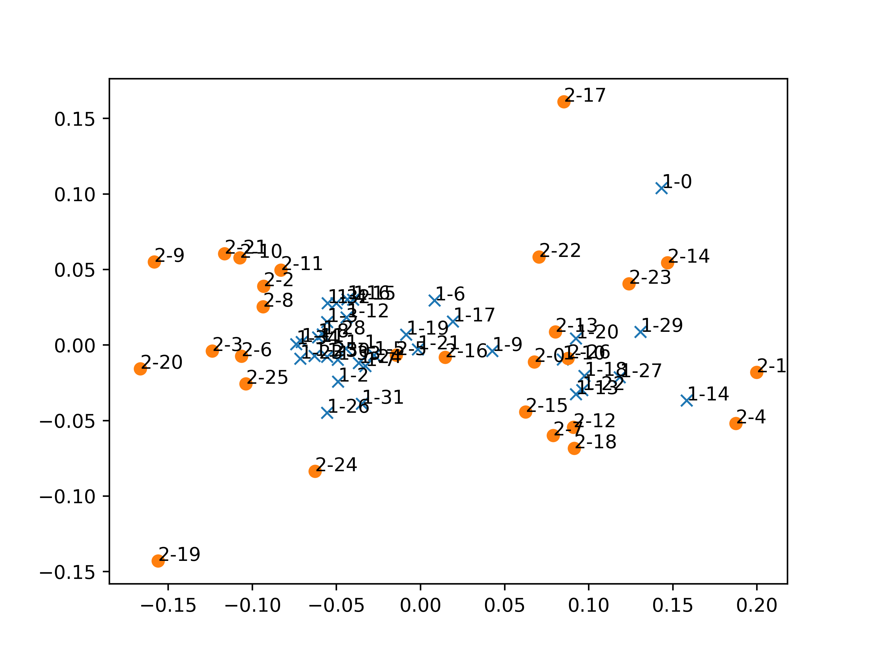
x
Bach chorales (BC)
Jazz standards (JS)
BC are more concentrated than JS, but what does it mean?

Slide 7
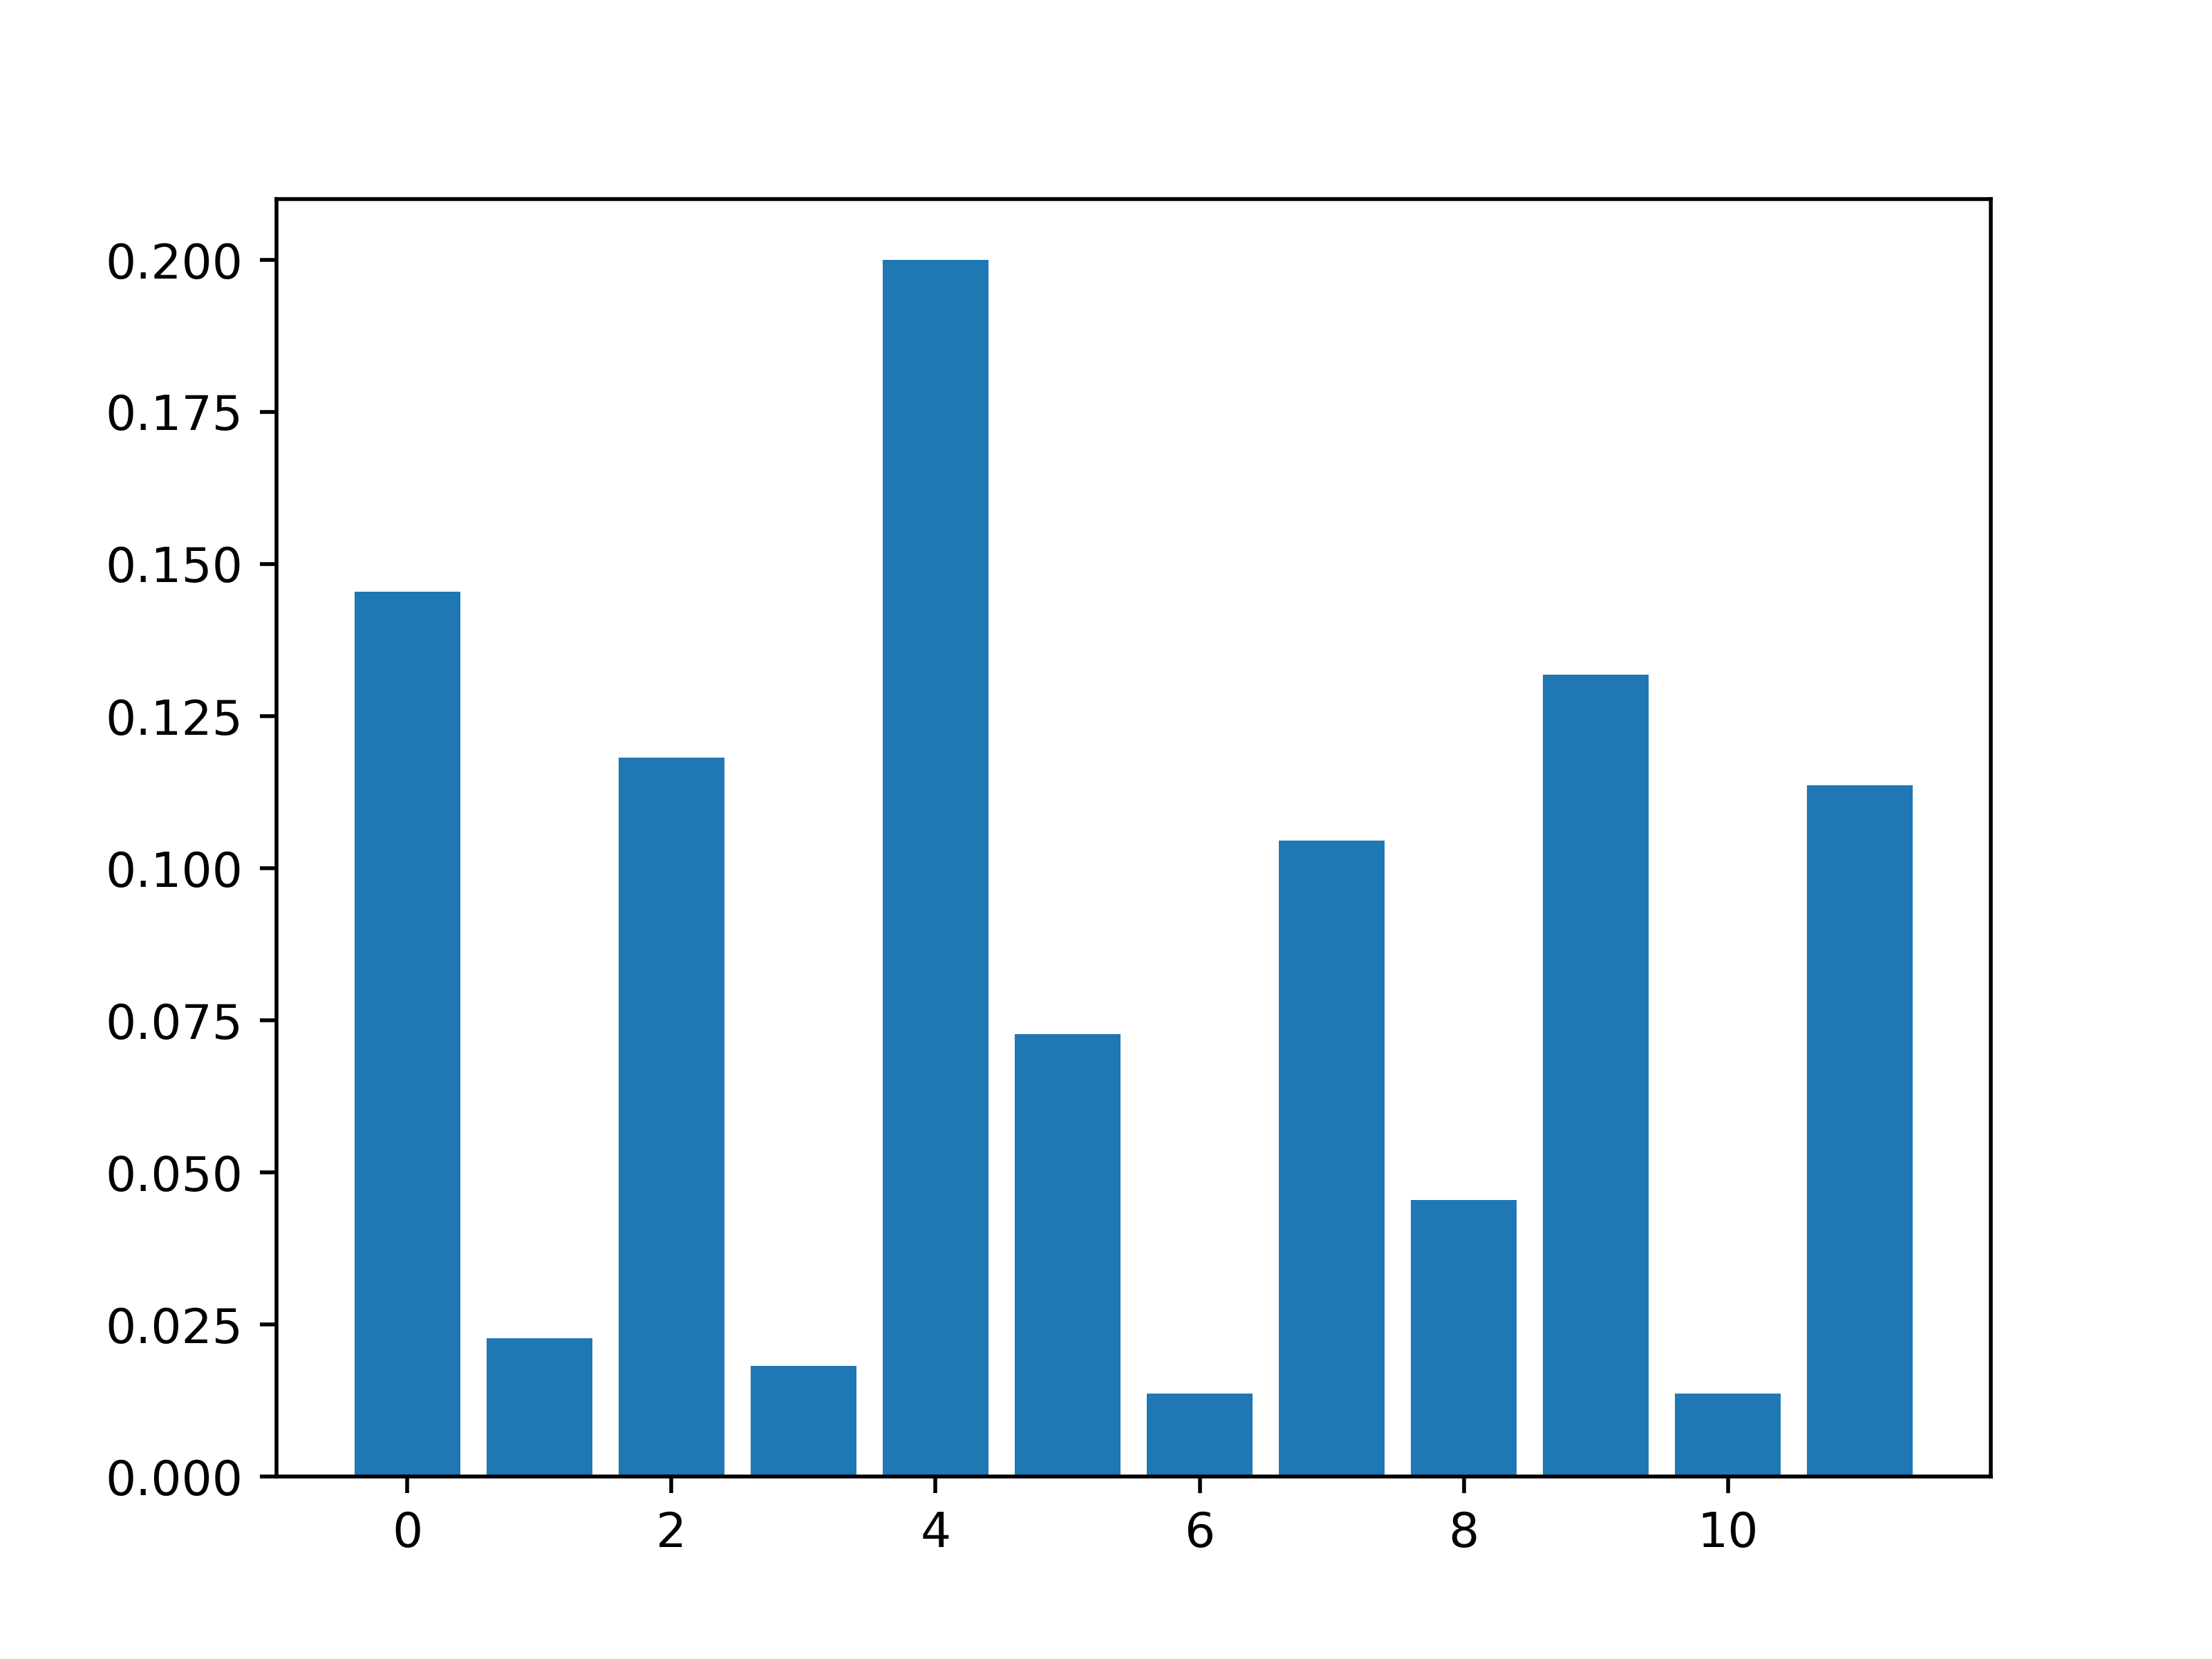
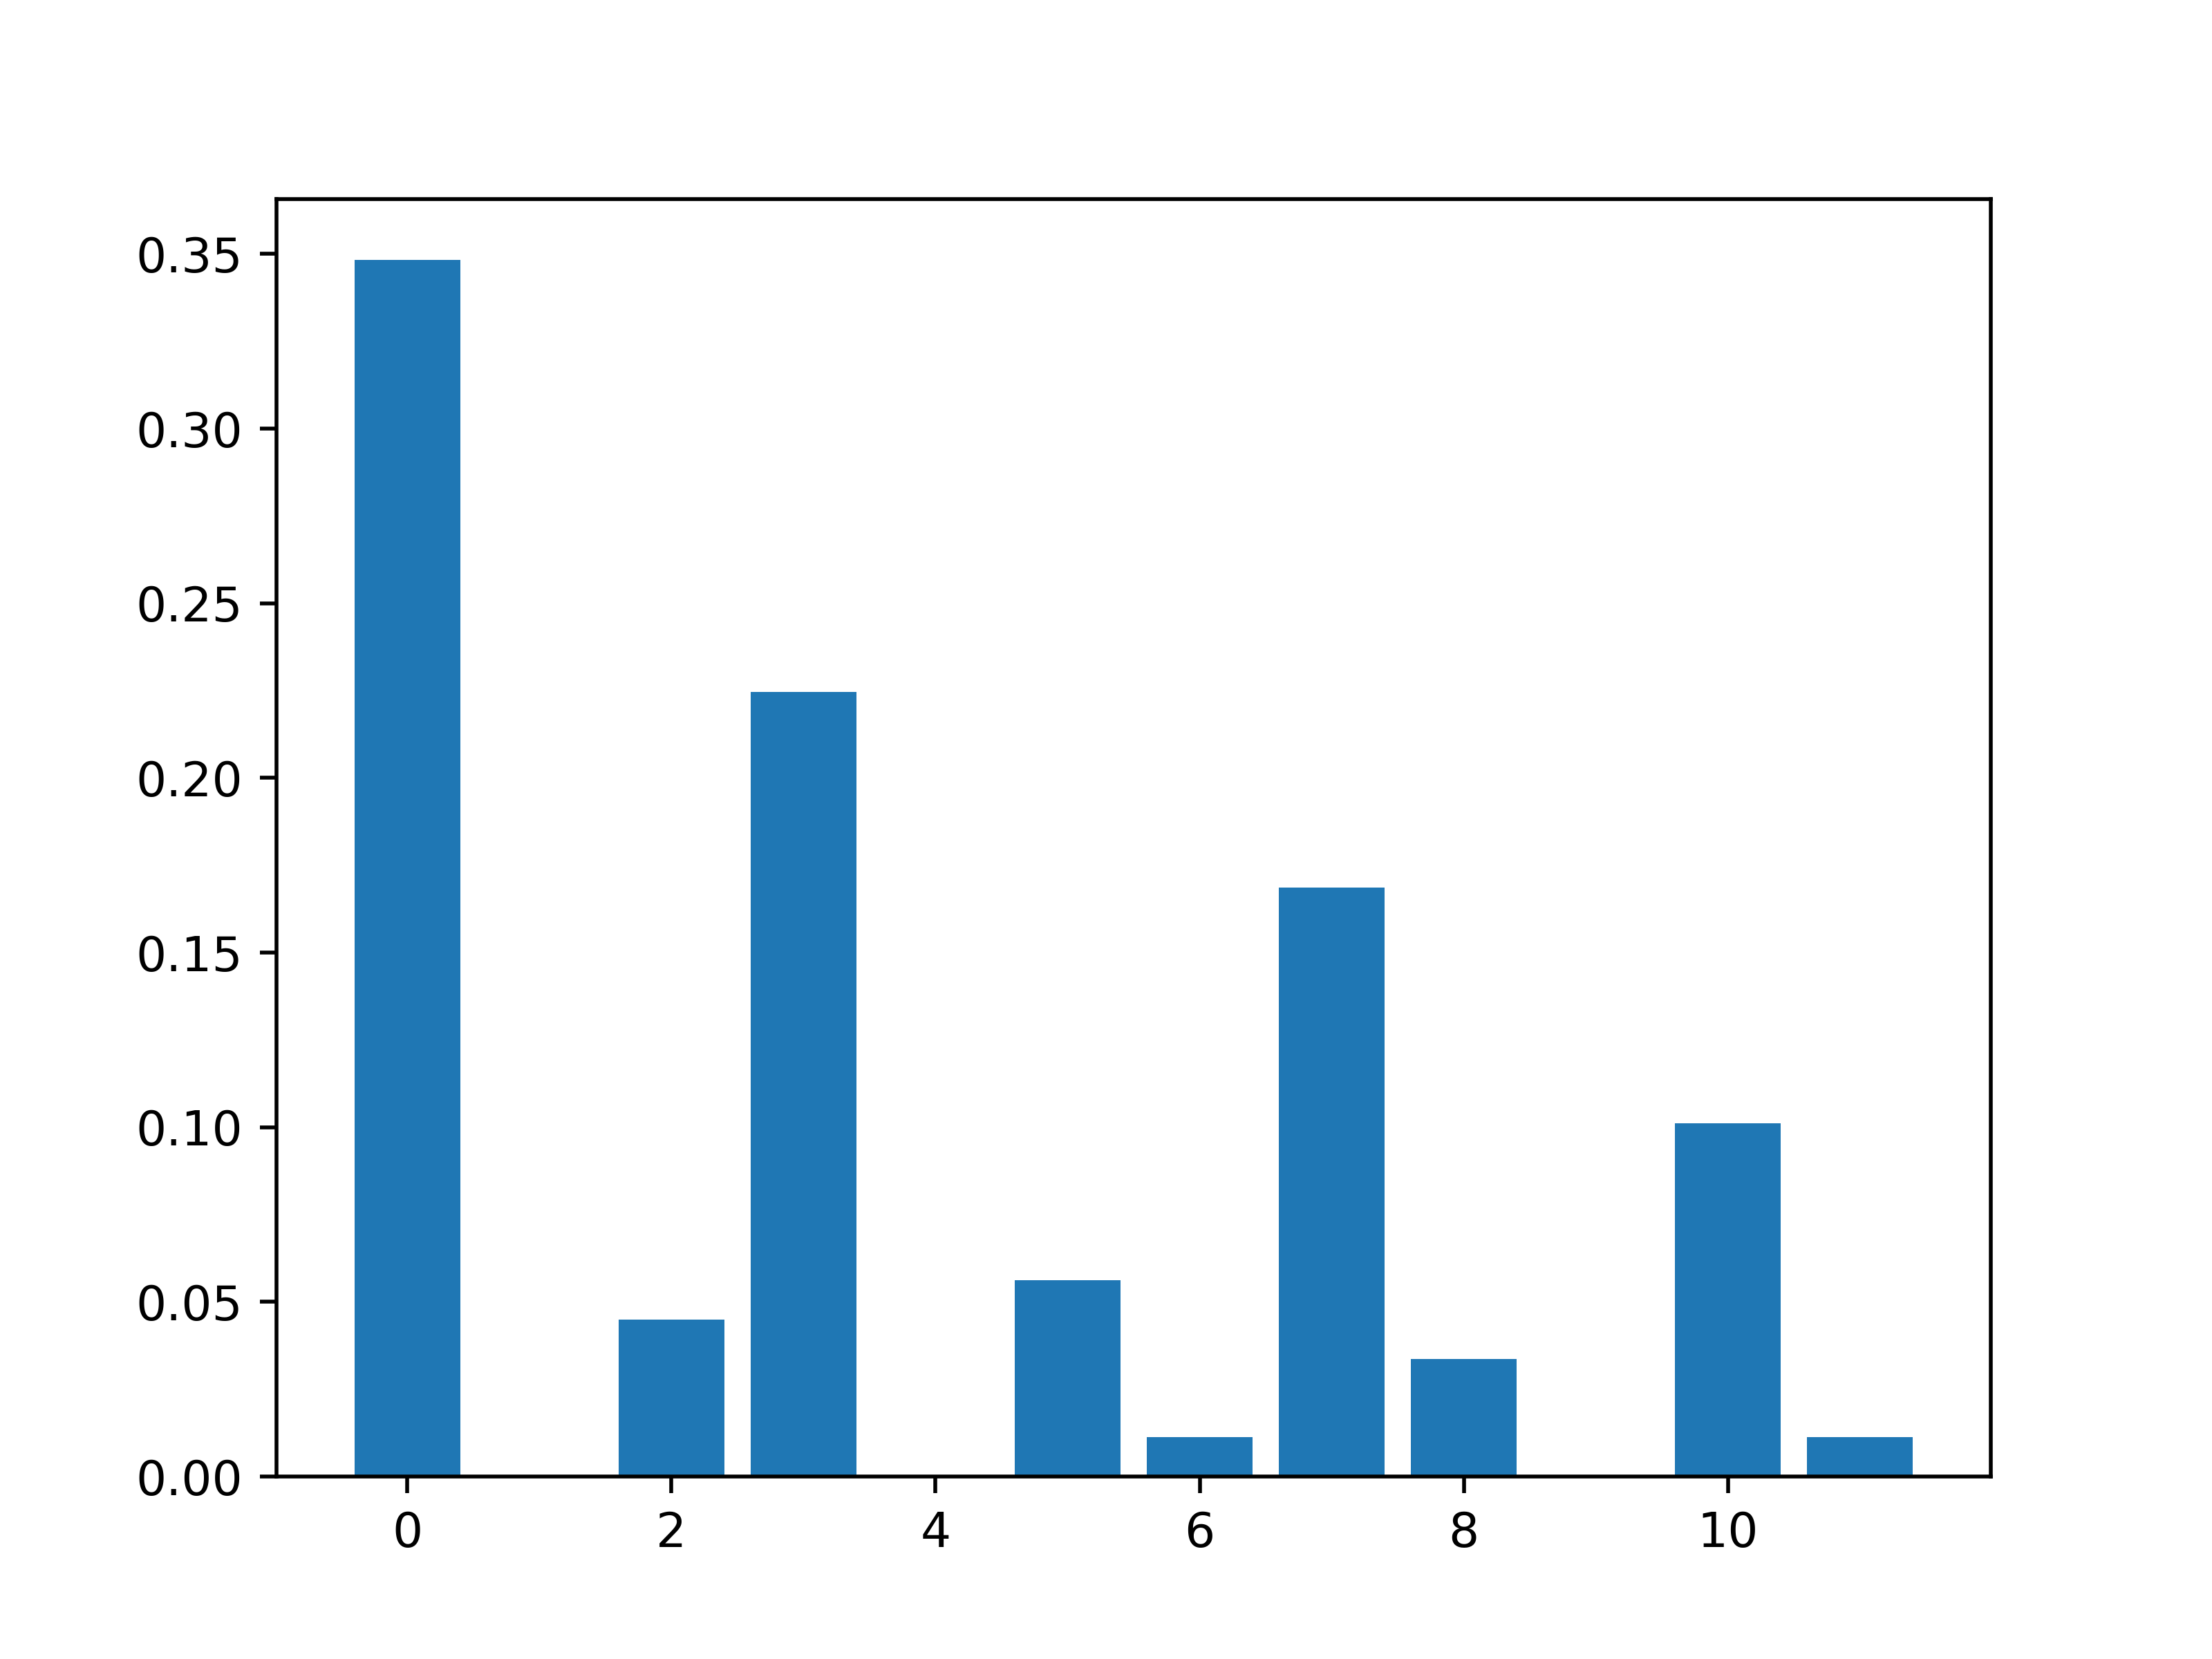
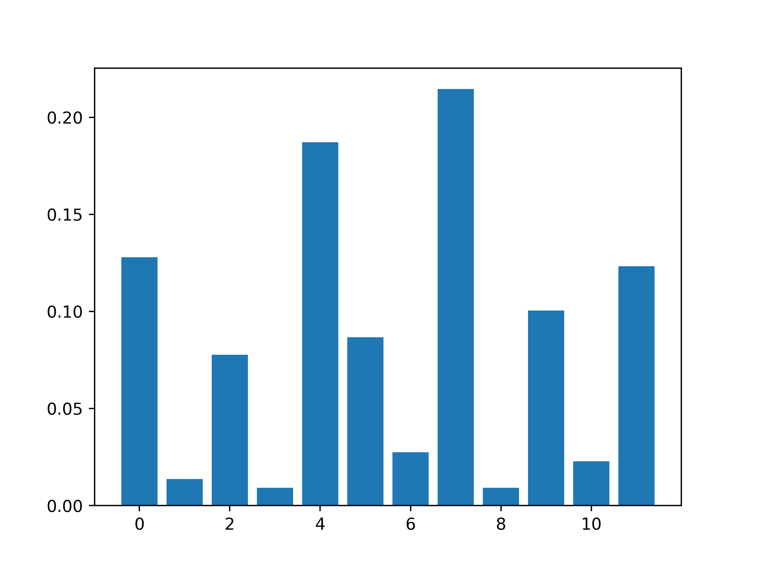
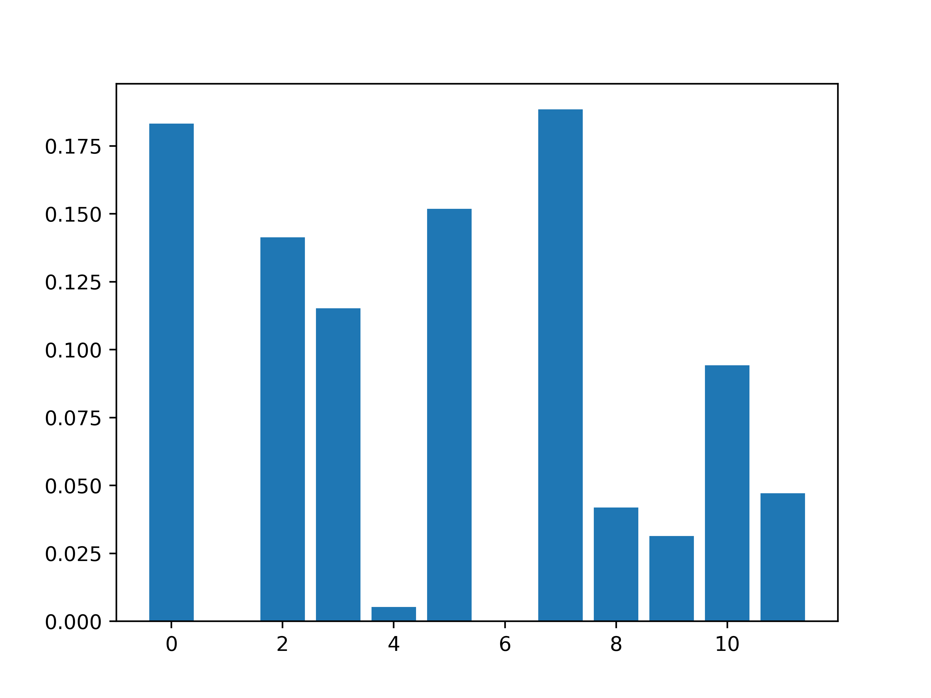
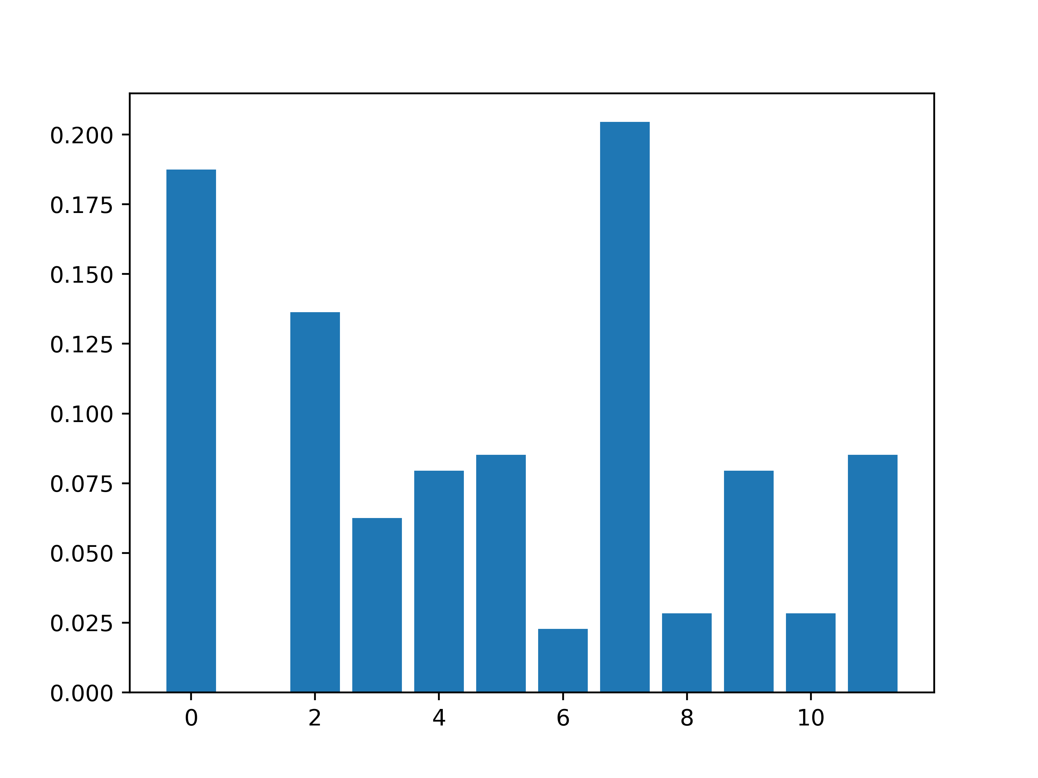
x
Bach chorales (BC)
Jazz standards (JS)
Major third
Minor third
What is the left-to-right dimension?

Slide 8
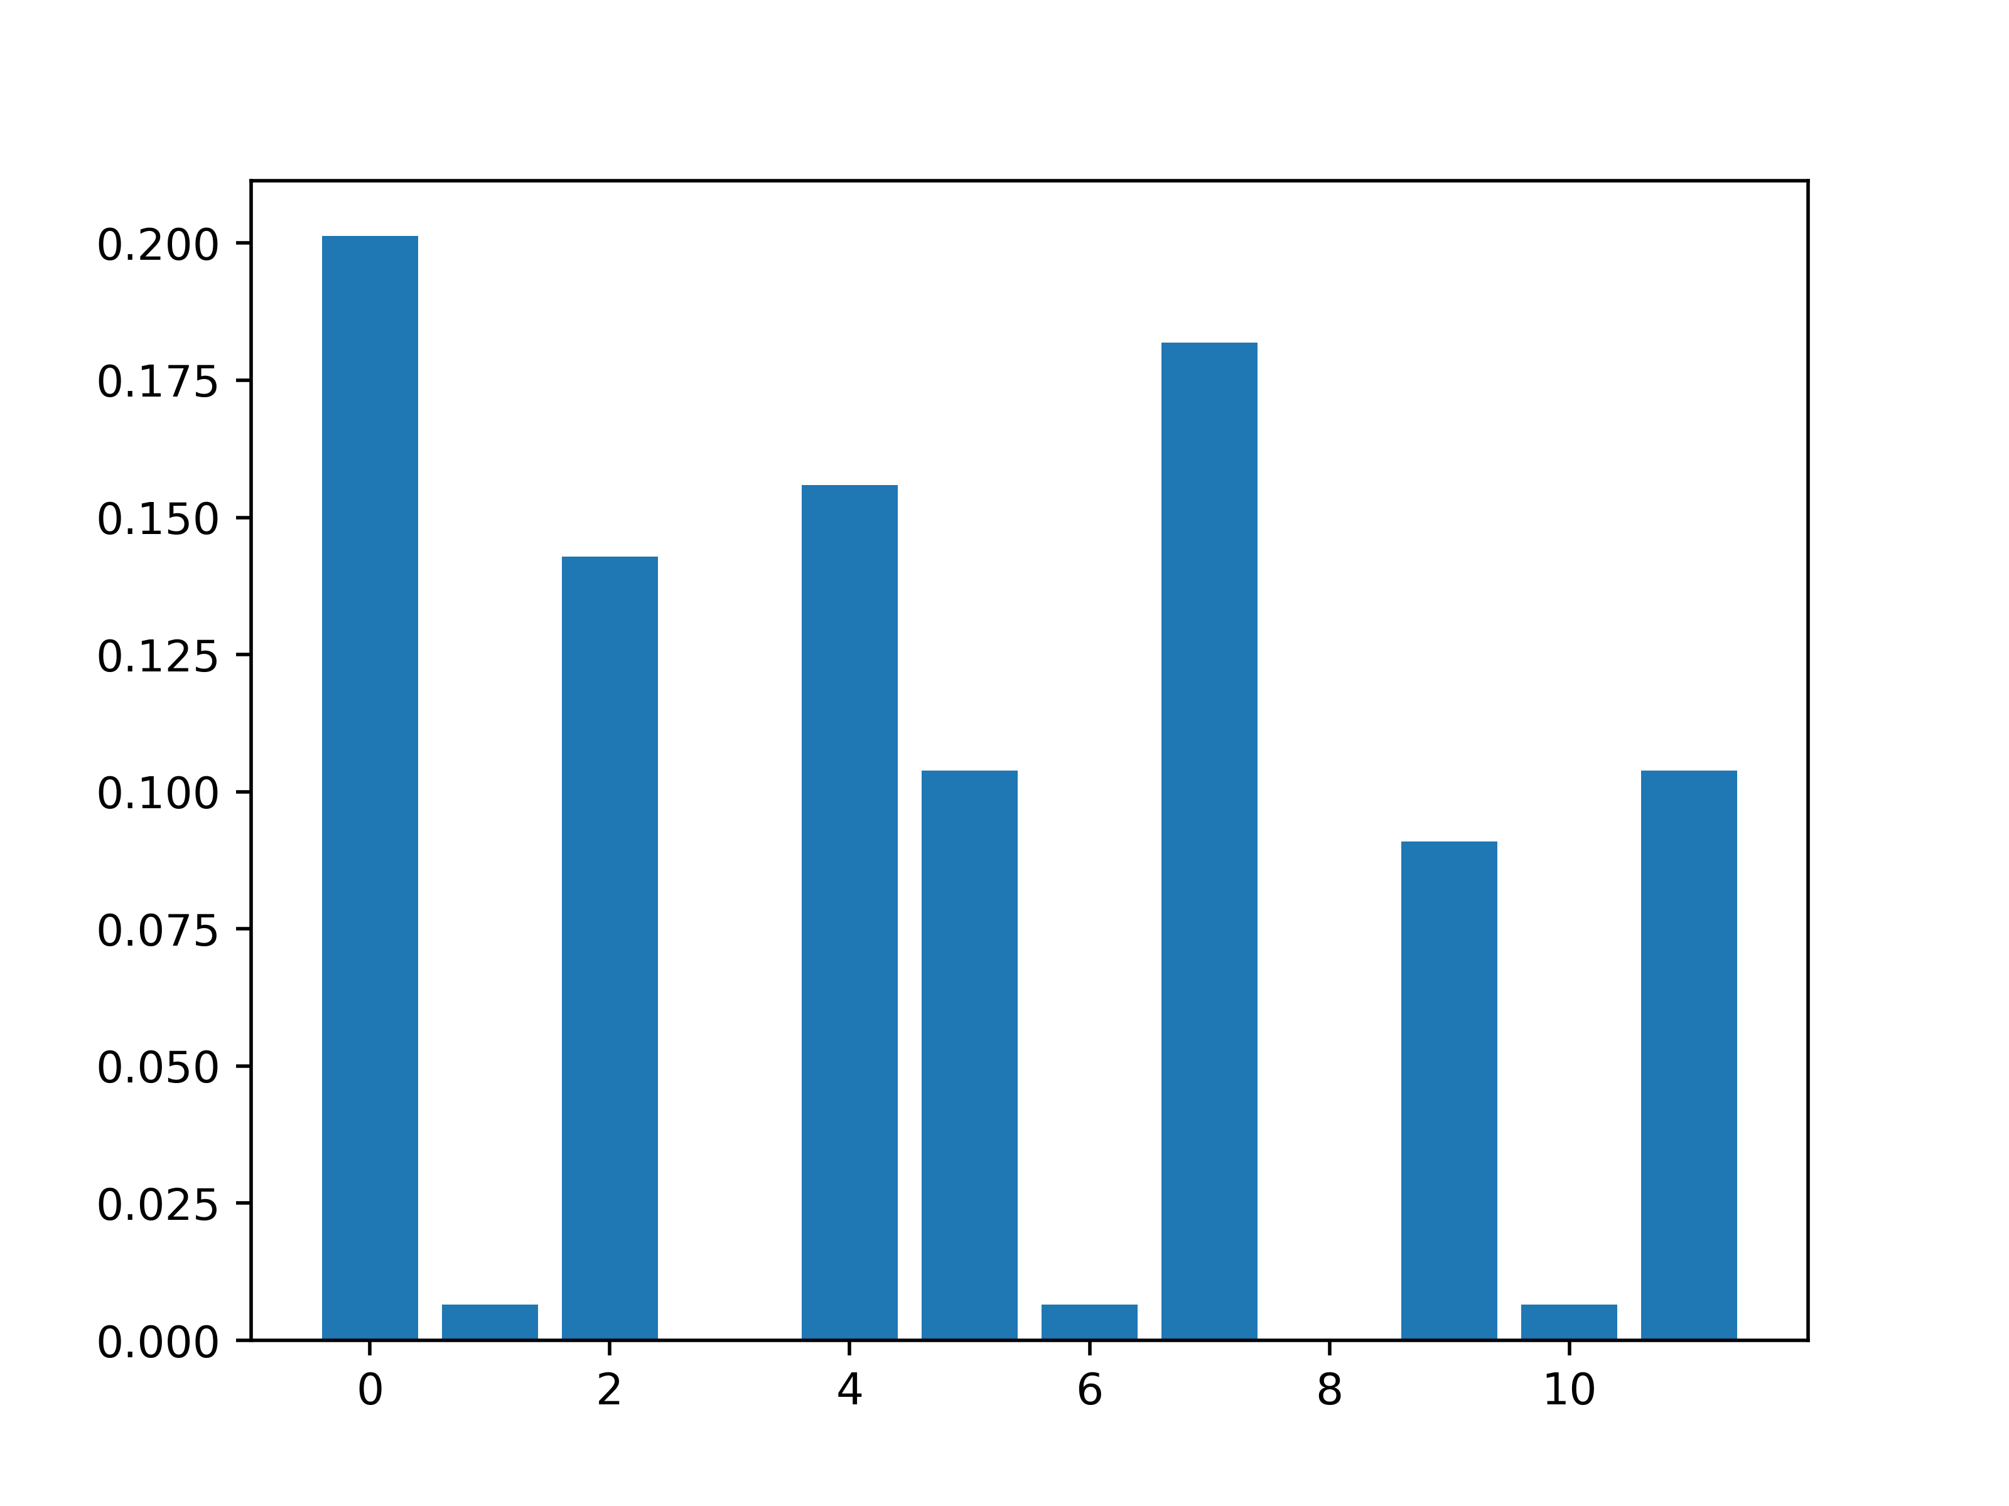
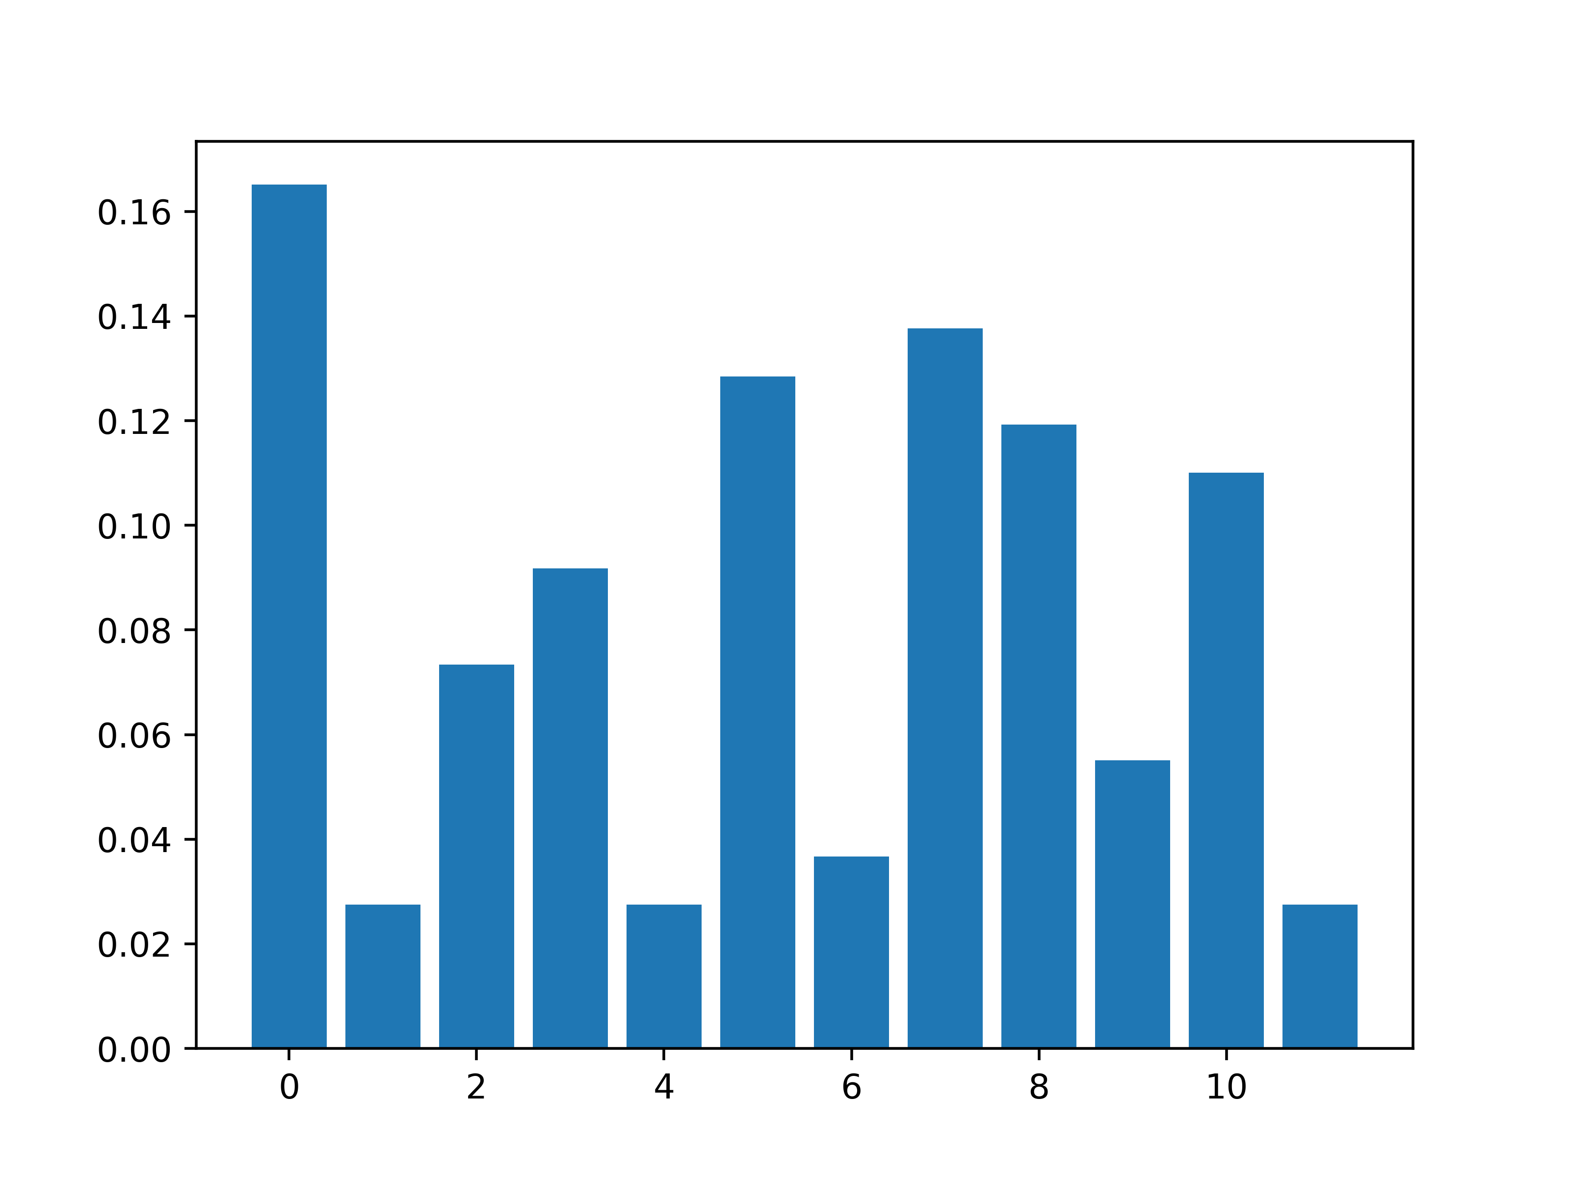
How much information is there in those rPCPs?
Which one should sound more “complex”?
How can we measure the “evenness” of the distribution?
Shannon Information Entropy!
<

Slide 9
x
Bach chorales (BC)
Jazz standards (JS)
What is PCA about?
Can be negative…

Slide 11
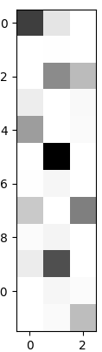
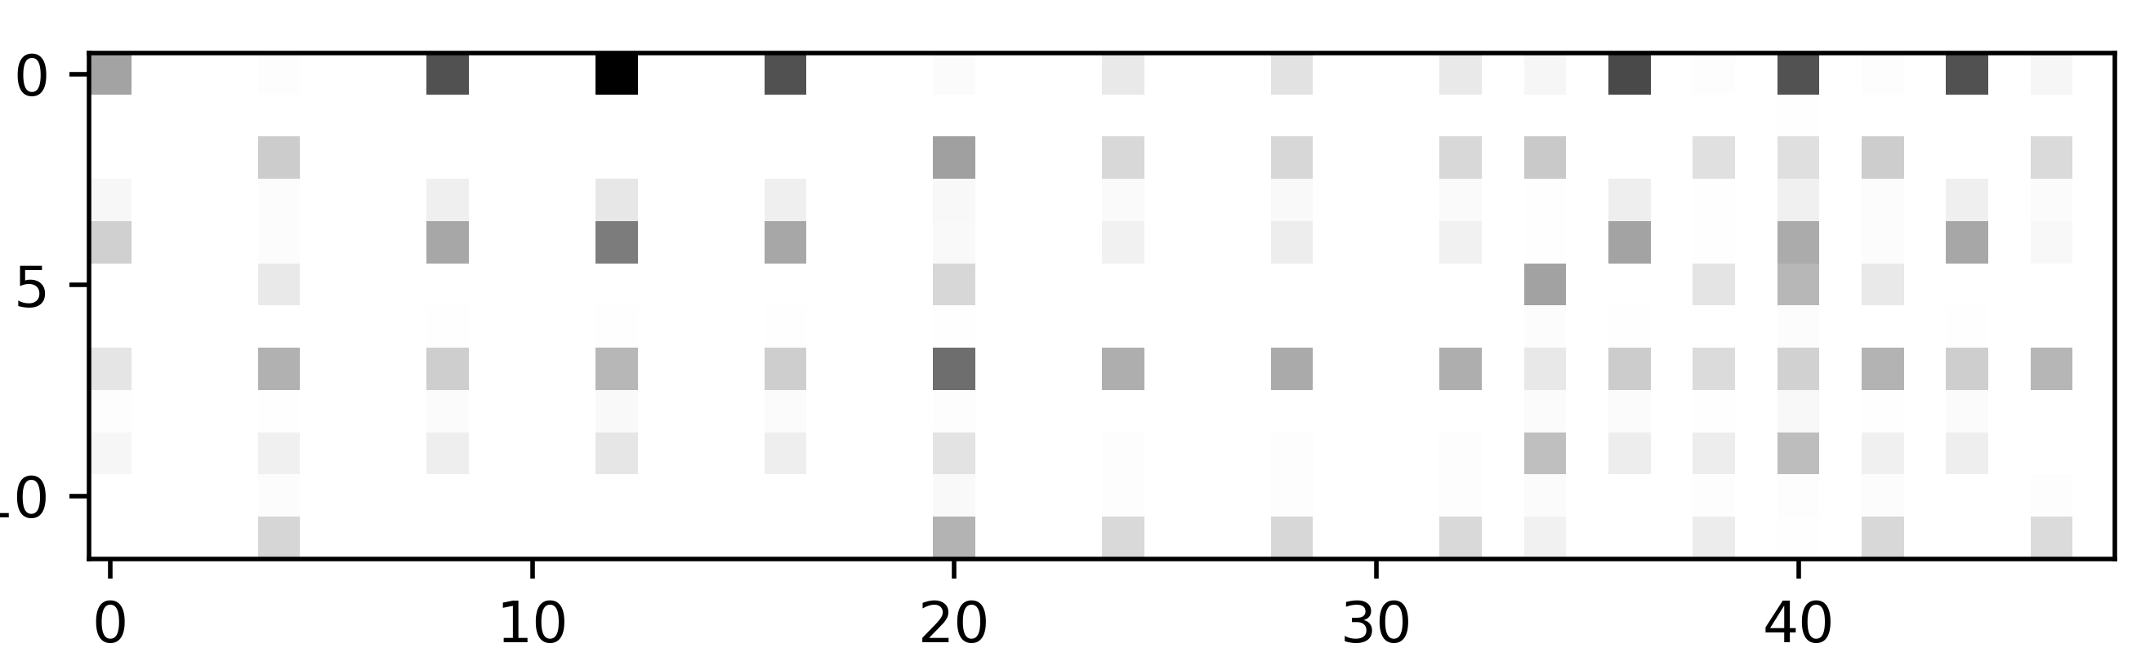
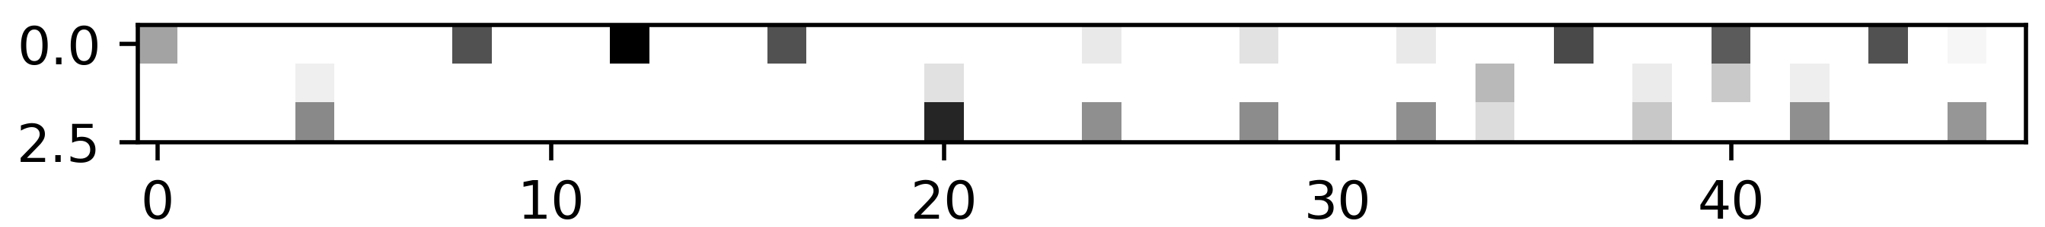
Non-negative Matrix Factorisation (NMF)
Bach chorales
Can be only non-negative…
But we lose information…
=
x

Slide 12

NMF for Bach chorales example

Slide 13
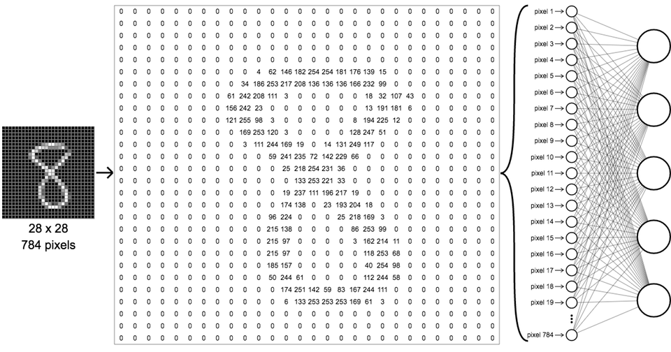
Supervised learning: classification
Method formulation
prediction for belonging to class 0
prediction for belonging to class 1
prediction for belonging to class 2
prediction for belonging to class 3
prediction for belonging to class 4
.
.
.

Slide 14
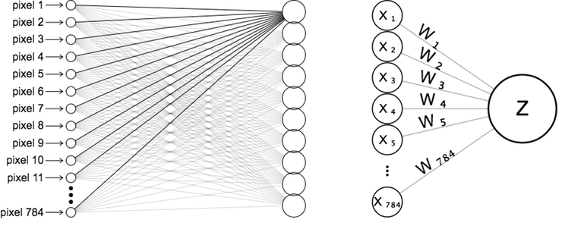
Supervised learning: classification
Let’s see what’s going on inside each class estimation

Slide 15
Supervised learning: classification
Doing it for for all class estimators
We have 10 class estimators, for 0, 1, …, 9
And for each estimator we have an equation:
…
Or in matrix form:
or
Linear Algebra and its Applications, Gilbert Strang, 4th Edition,
Brooks Cole, 2005. pages 19-26

Slide 16
Supervised learning: classification
Intuitive explanation
Each weight vector corresponds to one estimator
Each estimator shows how well each weight
vector is aligned with the pixel vector of
the digit it computes.

Slide 17
Supervised learning: classification
Intuitive explanation
Each weight vector corresponds to one estimator
Each estimator shows how well each weight
vector is aligned with the pixel vector of
the digit it computes.

Slide 18
Supervised learning: classification
Intuitive explanation
Each weight vector corresponds to one estimator
Each estimator shows how well each weight
vector is aligned with the pixel vector of
the digit it computes.
Actually, in this case the weight vector
that corresponds to each estimator is a
784-dimensional array or a 28x28 image.
How should the weight image of each estimator
look like?

Slide 19
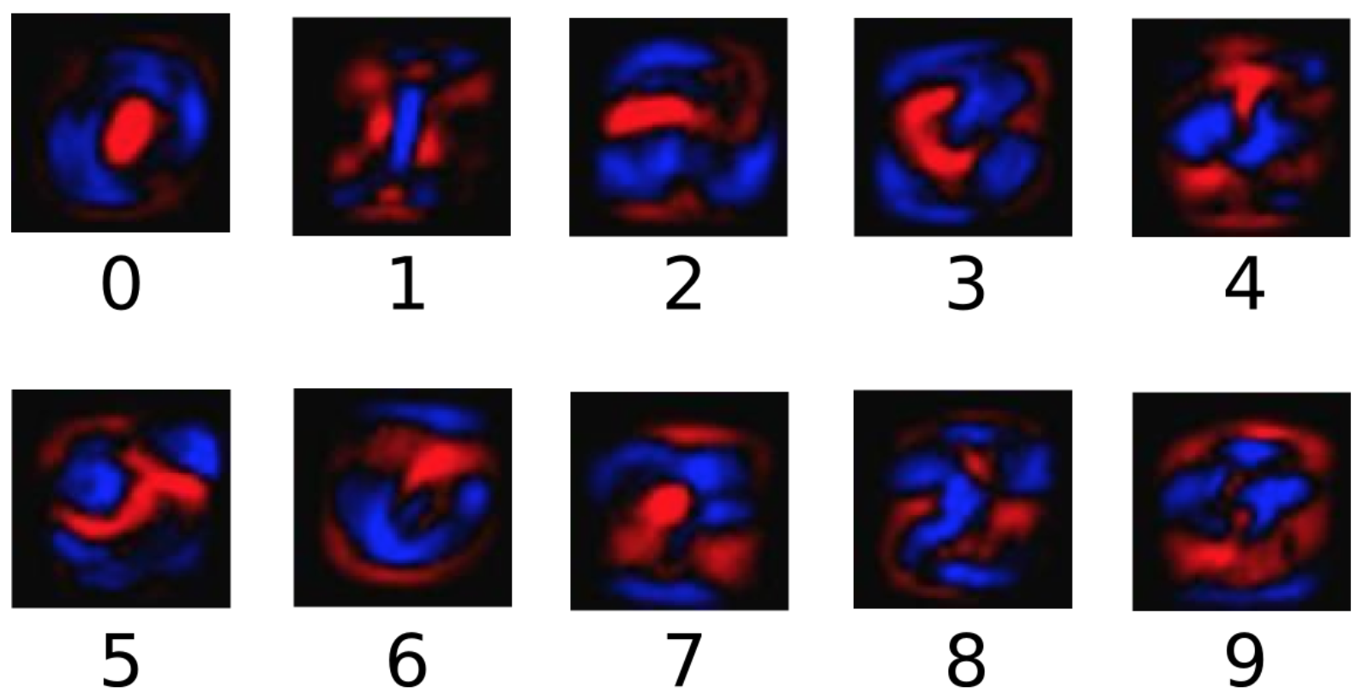
Supervised learning: classification
Weight vectors for each estimator represented as 28x28 images.

Slide 20
Black box when going deeper…

Slide 21
Introduction to statistical learning in symbolic music
Part 2/3
The test case of melodic harmonisation

Slide 22
Statistical learning – Markov models
We need to make a model for the generation of music that reflects some features
We have a dataset D of music pieces that have these desired features
Markov statistics for the desired features are learned from D
Music is generated under a simple Markov-Chain or a hidden Markov model approach.

Slide 23
Example of capturing 1st-order Markov statistics
Learning sequence: a a b a a c a b c
Transitions
First element
Final element
 | a | b | c
a
b
c
a
b
c
a
b
c
1st-order Markov assumption: the selection of an element is only dependent on its previous one

Slide 24
Example of capturing 1st-order Markov statistics
Learning sequence: a a b a a c a b c
Transitions
First element
Final element
 | a | b | c
a | 2 | 2 | 1
b | 1 | 0 | 1
c | 1 | 0 | 0
a | 1
b | 0
c | 0
a | 0
b | 0
c | 1
1st-order Markov assumption: the selection of an element is only dependent on its previous one

Slide 25
Example of capturing 1st-order Markov statistics
Learning sequences: a a b a a c a b c
b a b a a b c a c
Transitions
First element
Final element
 | a | b | c
a | 3 | 4 | 2
b | 3 | 0 | 2
c | 2 | 0 | 0
a | 1
b | 1
c | 0
a | 0
b | 0
c | 2
Important: these statistics should reflect at some extent
the intended style

Slide 26
Markov-Chain model
Transitions
First element
Final element
 | a | b | c
a | 0.3 | 0.5 | 0.2
b | 0.6 | 0 | 0.4
c | 1.0 | 0 | 0
a | 0.5
b | 0.5
c | 0
a | 0
b | 0
c | 1.0
Compose a new sequence based on these statistics
For generating each element, a dice-based process
decides a ‘probability threshold’
Not necessarily the most probable scenario is followed

Slide 27
Hidden Markov model (HMM)
Observation: c d e d e f e d c d e d c e d
States: C F C G
First element
C | 1.0
F | 0
G | 0
Transitions
Melody | State
 | C | F | G
C | 0 | 0.5 | 0.5
F | 1.0 | 0 | 0
G | 1.0 | 0 | 0
 | c | d | e | f
C | 0.2 | 0.3 | 0.5 | 0
F | 0.2 | 0.4 | 0.2 | 0.2
G | 0 | 1 | 0 | 0
Final element
C | 0
F | 0
G | 1.0

Slide 28
Hidden Markov model (HMM)
Observation: e e f g g f e d c c d e e d d
States: ? ? ? ?
First element
Viterbi algorithm
C | 1.0
F | 0
G | 0
Transitions
Melody | State
 | C | F | G
C | 0 | 0.5 | 0.5
F | 1.0 | 0 | 0
G | 1.0 | 0 | 0
 | c | d | e | f
C | 0.2 | 0.3 | 0.5 | 0
F | 0.2 | 0.4 | 0.2 | 0.2
G | 0 | 1 | 0 | 0
Final element
C | 0
F | 0
G | 1.0

Slide 29
Melodic harmoniser example
Training the system:
Generative Theory of Tonal Music
Tonal Pitch Space

Slide 30
Melodic harmoniser example
Input:

Slide 31
Melodic harmoniser example
Output:

Slide 32
Melodic harmoniser example
Overview:

Slide 33
Examples:

Slide 34
Computational Creativity and Conceptual Blending
Part 3/3
Blending harmonic spaces

Slide 35
Forms of Creativity
Boden has proposed three forms of creativity:
Exploratory
Transformational
Combinational
Combinational creativity, has proved to be the hardest to describe formally (Boden 1990).

Slide 36
Conceptual Blending
Conceptual blending is a cognitive theory developed by Fauconnier and Turner (2001)
Elements from diverse, but structurally-related, mental spaces are ‘blended’ giving rise to new conceptual spaces.
Such spaces often posses new powerful interpretative properties allowing better understanding of known concepts or the emergence of novel concepts.

Slide 37
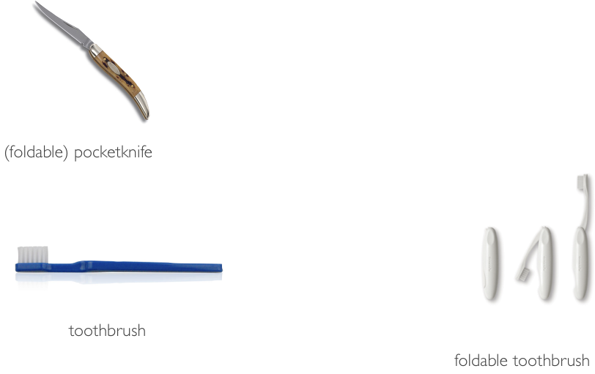
Conceptual Blending
Example from the COINVENT project (2013-2016)
http://coinvent.uni-osnabrueck.de/

Slide 38
Blending in humour
Question
What do people who are insomniacs, dyslectics and agnostics do at night?
Answer
They stay awake wondering if the is a dog.

Slide 39
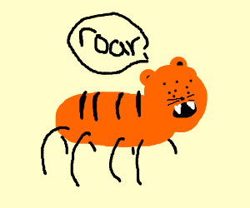
Conceptual blending framework

Slide 40



Conceptual Blending – a musical example
Example from the COINVENT project (2013-2016)
http://coinvent.uni-osnabrueck.de/
See also the CHAMELEON website:
http://ccm.web.auth.gr/blendedharmonisations.html

Slide 41
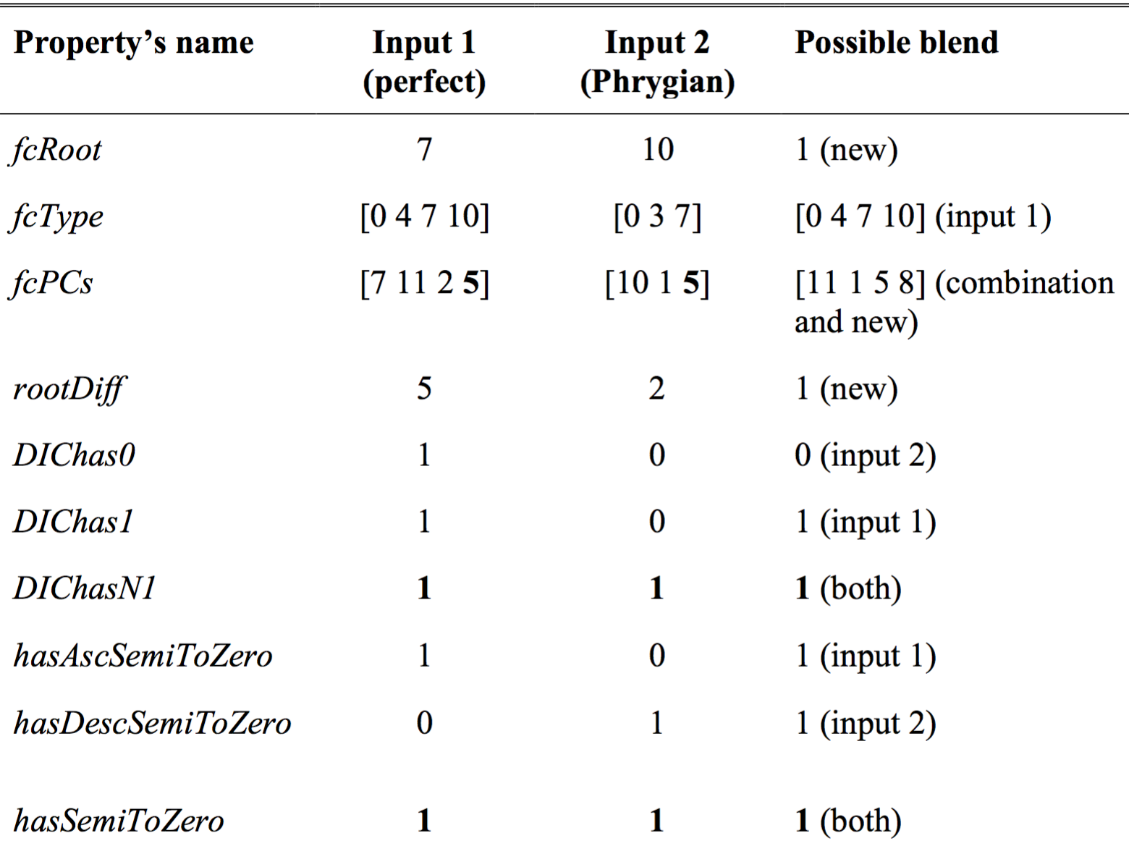
Conceptual Blending – nuts and bots
Example from the COINVENT project (2013-2016)
http://coinvent.uni-osnabrueck.de/
See also the CHAMELEON website:
http://ccm.web.auth.gr/blendedharmonisations.html

Slide 42

Blending in harmony
Creating novel blends (rather than interpreting existing blends)
Emphasis on the creation of new music as a product of structural blending (not creating new musicogenic or referential blends).
Creative Harmonisation of MELodies via LEarning & bLEnding of ONtologies
A system that harmonises melodies
The user inputs a melody
The output is a harmonised melody
The produced harmony features blended characteristics from different learned harmonic idioms.
http://ccm.web.auth.gr/chameleonmain.html

Slide 43
Blending in harmony
CHAMELEON harmonisation assistant

Slide 44
Harmonic Dataset
The dataset comprises seven broad categories of musical idioms, further divided into sub-categories, and presented in the following list:
Modal harmonisation in the Middle Ages (11th – 14th centuries): includes subcategories of the Medieval harmonic styles of Organum and Fauxbourdon
Modal harmonisation in the Renaissance (15th – 17th centuries): includes modal music from the 16th – 17th centuries along with modal chorales
Tonal harmonisation (17th – 19th centuries): includes a set of the Bach Chorales, the Kostka-Payne corpus
Harmonisation in National Schools (19th – 20th centuries): includes 19th – 20th century harmonisation of folk songs from Norway, Hungary and Greece
Harmonisation in the 20th century: includes mainly vocal music by Cl. Debussy, P. Hindemith, E. Whitacre, I. Stravinsky, among others. Also, includes 20th-century harmonic concepts extracted from short musical excerpts
Harmonisation in folk traditions: includes Tango (classical and nuevo styles), Epirus polyphonic songs and Rebetiko songs
Harmonisation in 20th-century popular music and jazz: includes mainstream jazz, piano pieces by Bill Evans and a collections of songs from The Beatles

Slide 45
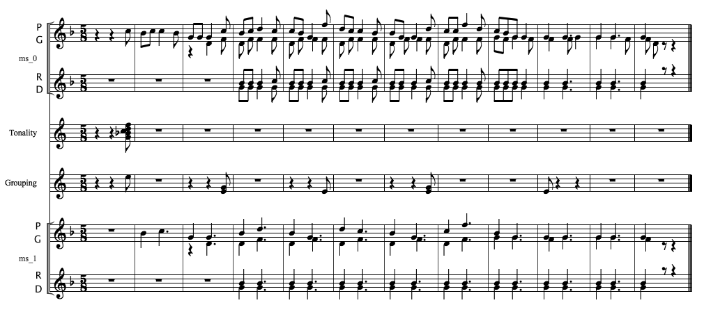
Annotated score
Tin Ammo Ammo Pigena
\

Slide 46
Statistical learning of harmonies
The harmoniser is based on a statistical learning approach that combines different learning modules:
chord types
chord transitions
cadences
bass line voice leading
The training material comprises many diverse musical idioms, annotated by human experts.

Slide 47
GCT representation – Learning chords
It is a representation that is a generalisation of the standard
tonal typology, applicable to any type of music.
General Chord Type Algorithm (GCT algorithm)
INPUT:
Consonant/dissonant interval vector , e.g. [1,0,0,1,1,1,0,1,1,1,0,0]
Tonality/key
ALGORITHM CORE:
Reordering of pitch classes (most compact form) such that consonant intervals constitute the ‘base’ of the chord (left-hand side) & pitches that introduce dissonant intervals in relation to the ‘base’ are the extension (to the right)
OUTPUT:
Chord-type and extension
Root of chord (root-finding)
Relative root position in current key

Slide 48
Beethoven, Sonata 14, op.27-2 (reduction of first measures)
G. Gershwin, Rhapsody in Blue (reduction of first five measures)

Slide 49
Chord learning & generation
Idiom dependent probabilistic harmonization under chord constraints (constrained HMM)
Chord transitions learned from an idiom
Novel sequences generated that statistically:
preserve the learned characteristics, AND
are constrained by fixed ‘checkpoint’ chords

Slide 50
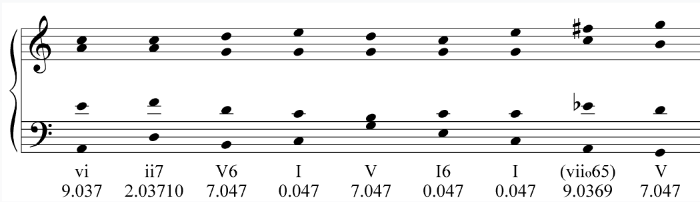
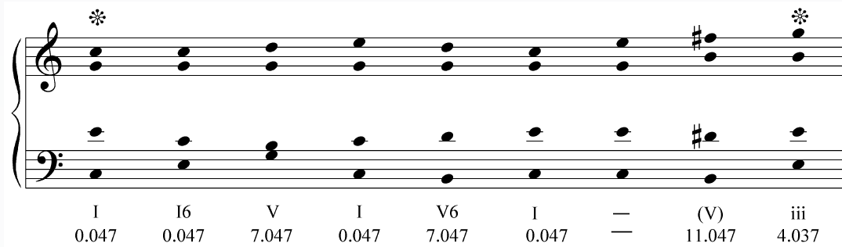
Harmonisations with different constraints

Slide 51
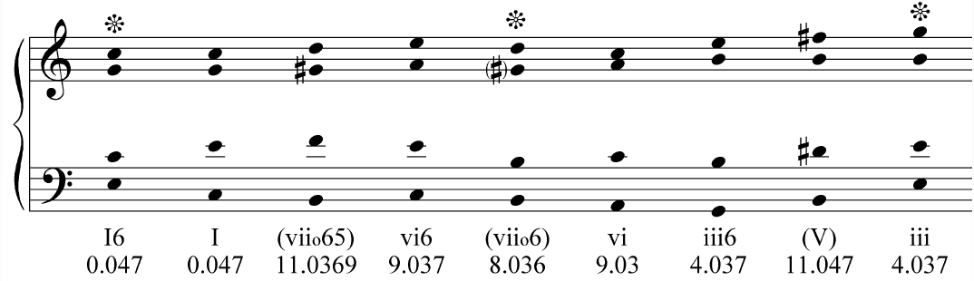
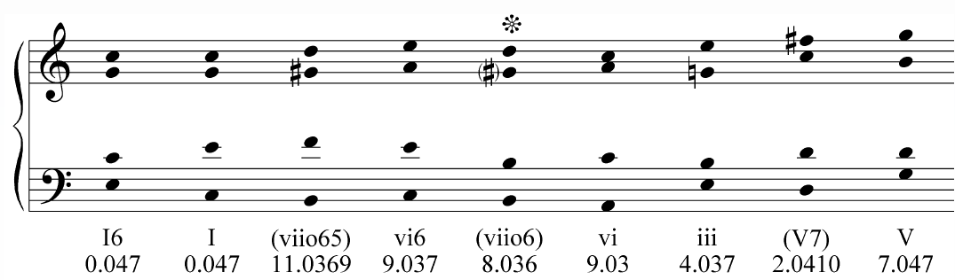

Slide 52
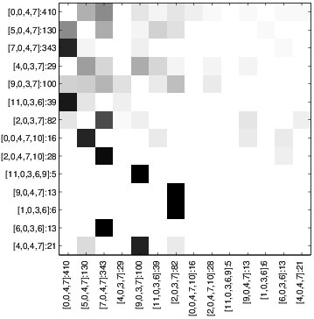
Chord transition space
Learned from data

Slide 53
Learning bass voice leading and assigning intermediate voices
Bass voice HMM
Chord inversion statistics
Melody-to-bass distance distribution
Rule-based assignment of intermediate voices

Slide 54
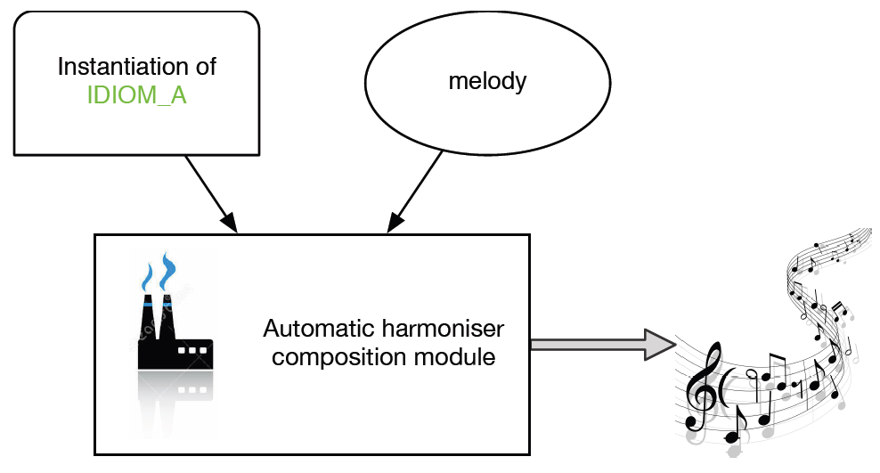
Melodic Harmonisation
Blending is relevant in the sense that the implied harmonic space of melody and an appropriate harmonic space are combined.

Slide 55
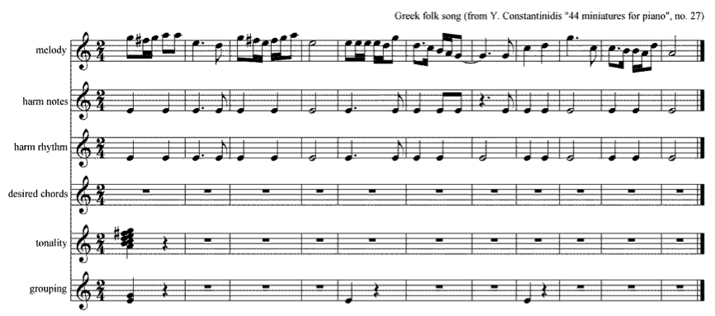
Melodic Input
At this stage, the input melody is manually annotated by the user as to harmonic rhythm, harmonically important notes, key and phrase structure. The user provides the information and an xml file is produced.

Slide 56
Example 1. PE - Polyphonic Epirus
Melody of Tin Ammo Ammo Pigena polyphonic song from Epirus harmonised by the cHMM model

Slide 57
Example 2. BC - Polyphonic Epirus
First two melodic phrases from J.S.Bach’s Chorale nr. 110 ("Vater unser im Himmelreich"), harmonised by the cHMM model in Epirus polyphonic song style

Slide 58
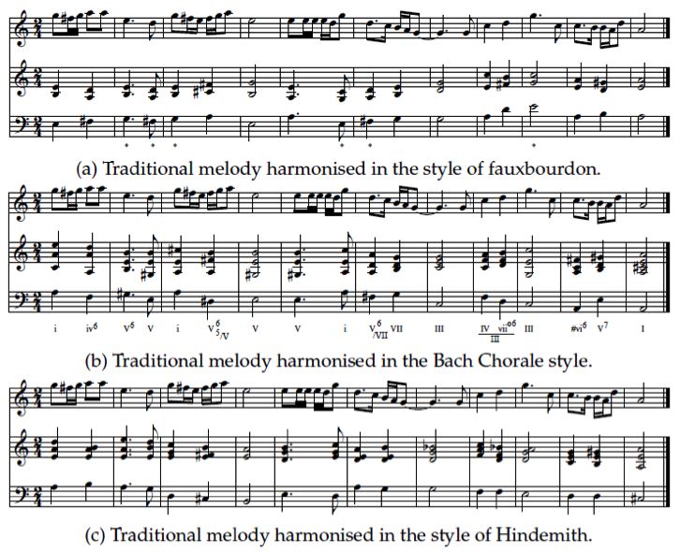

Diverse Musical Idioms

Slide 59
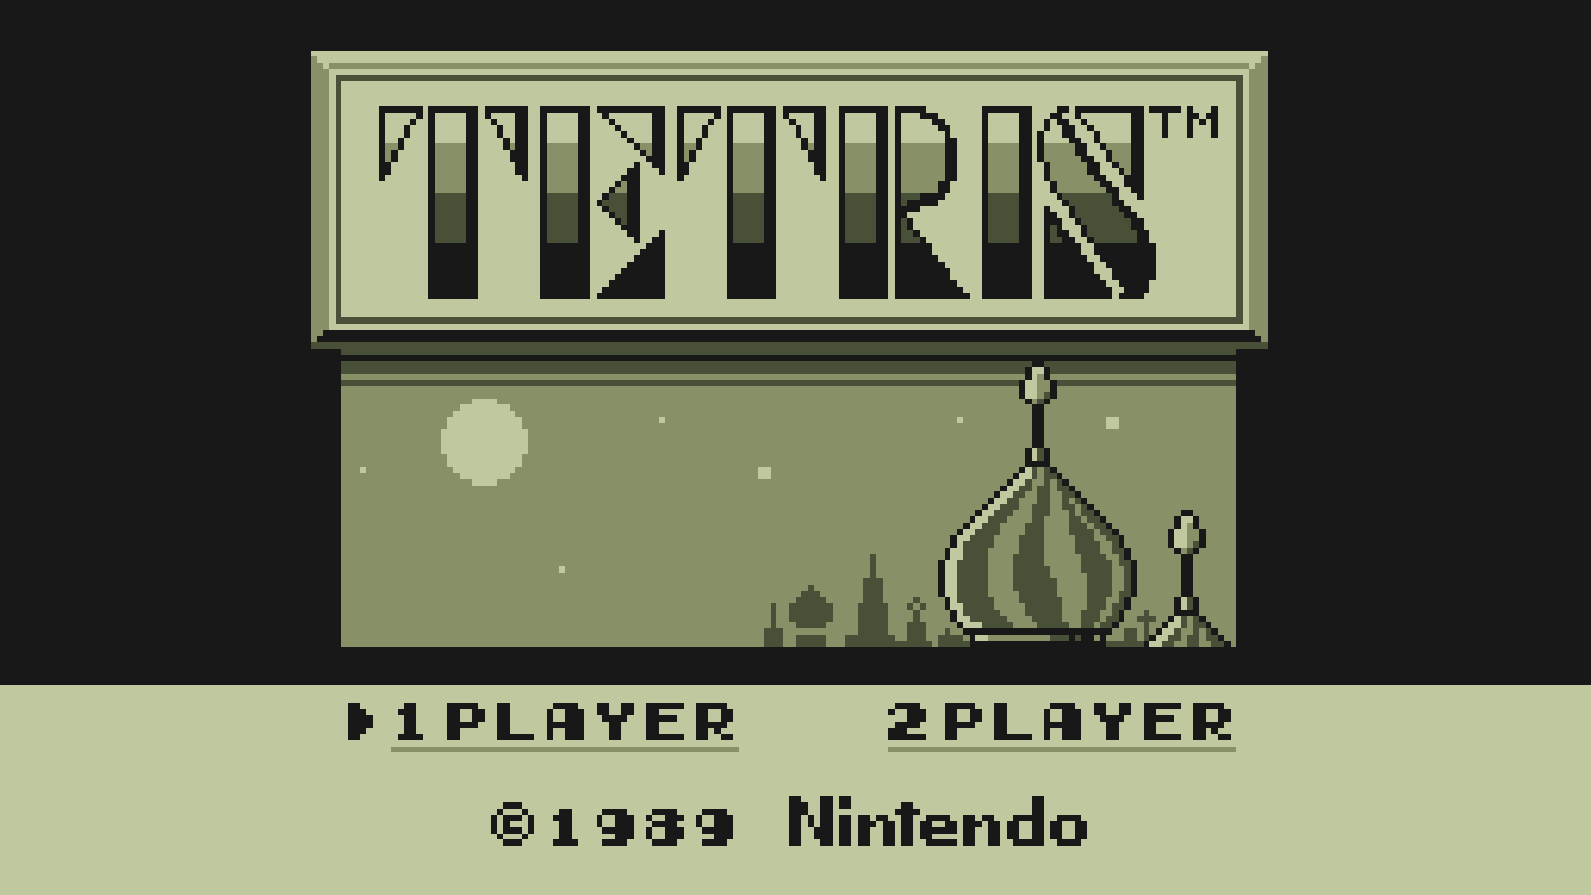
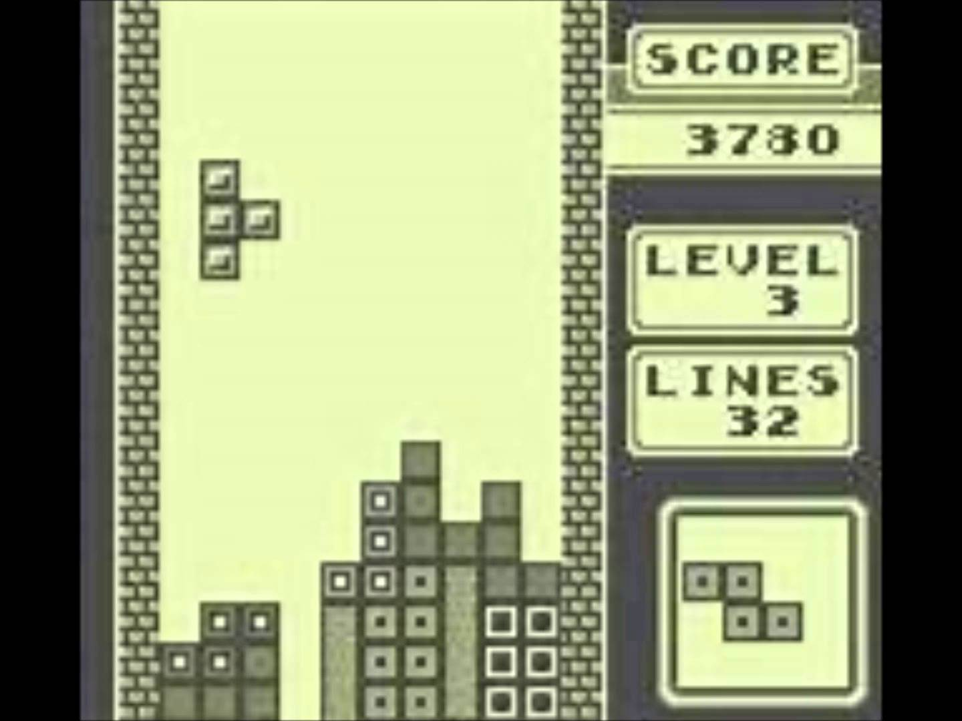
Tetris tune harmonisation
Tetris theme
Korobeneiki (russian folk song)
Harmonisations
Bach chorales
Modal chorales
Kostka-Payne
Konstantinidis
Jazz
Hindemith
Epirus folk songs
Organum
Faux Bourdon

Slide 60
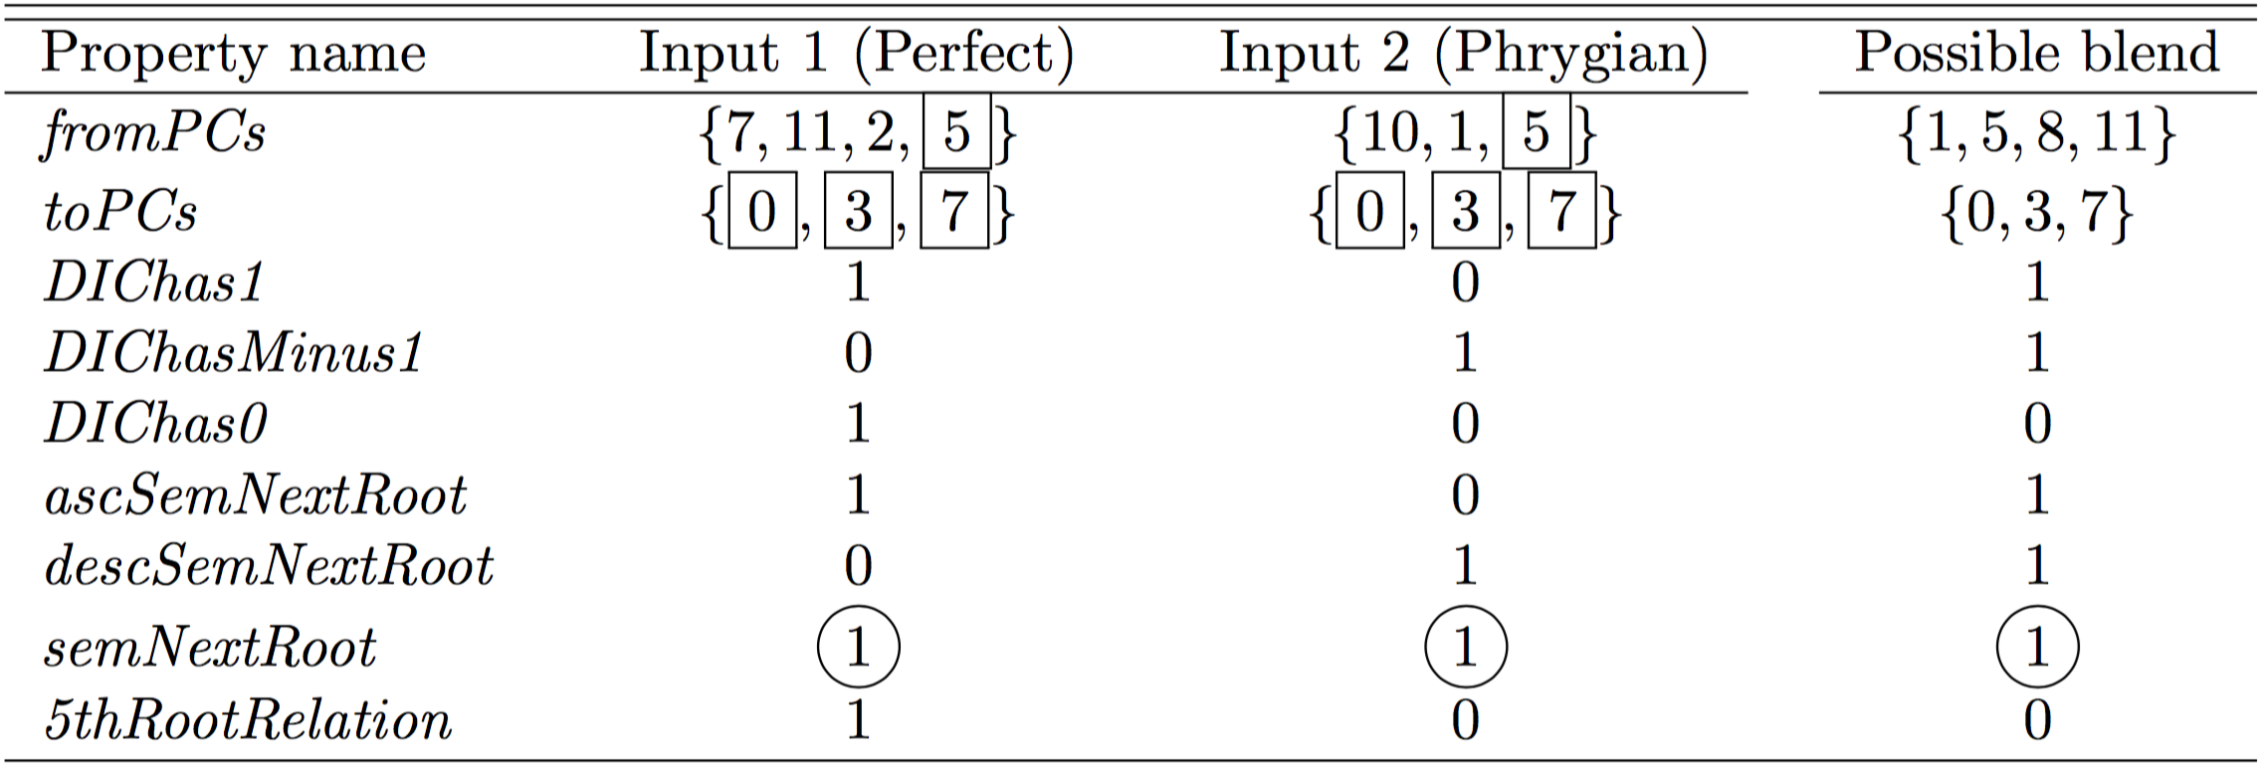
Chord level blending (cadences)

Slide 61
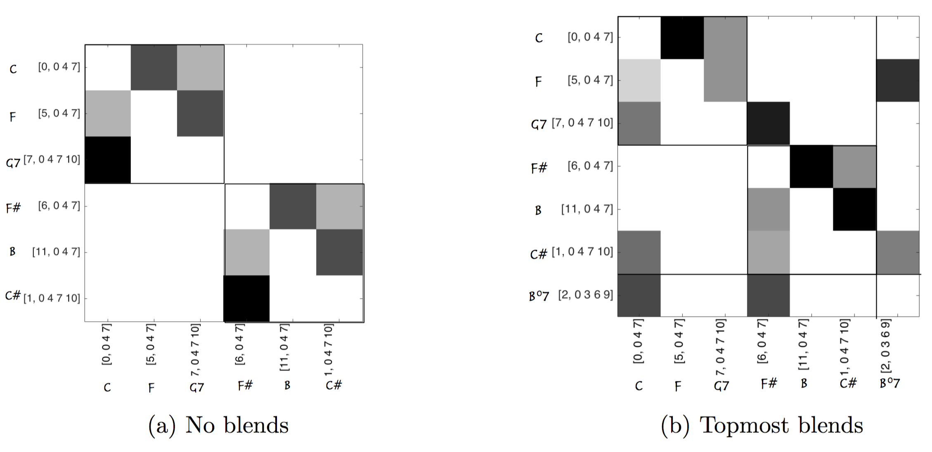
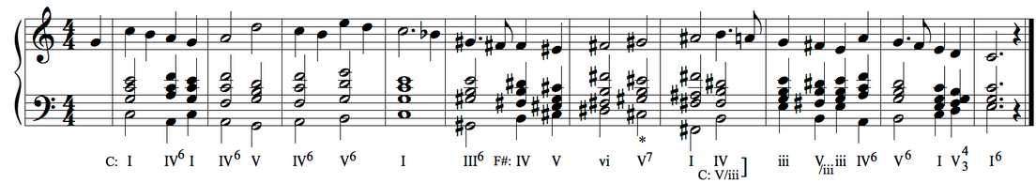
Blending chord transition matrices
User selects two idioms from a list.
System automatically blends the most common transitions
The ‘best’ resulting blends are integrated in a compound matrix.

Slide 62

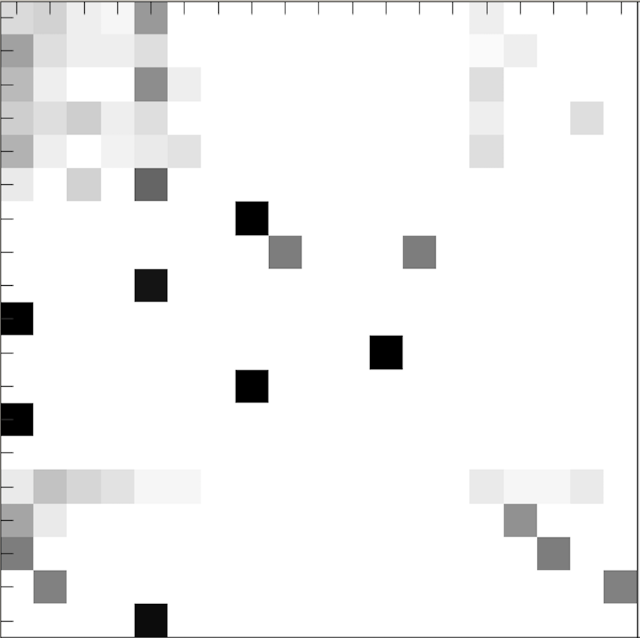
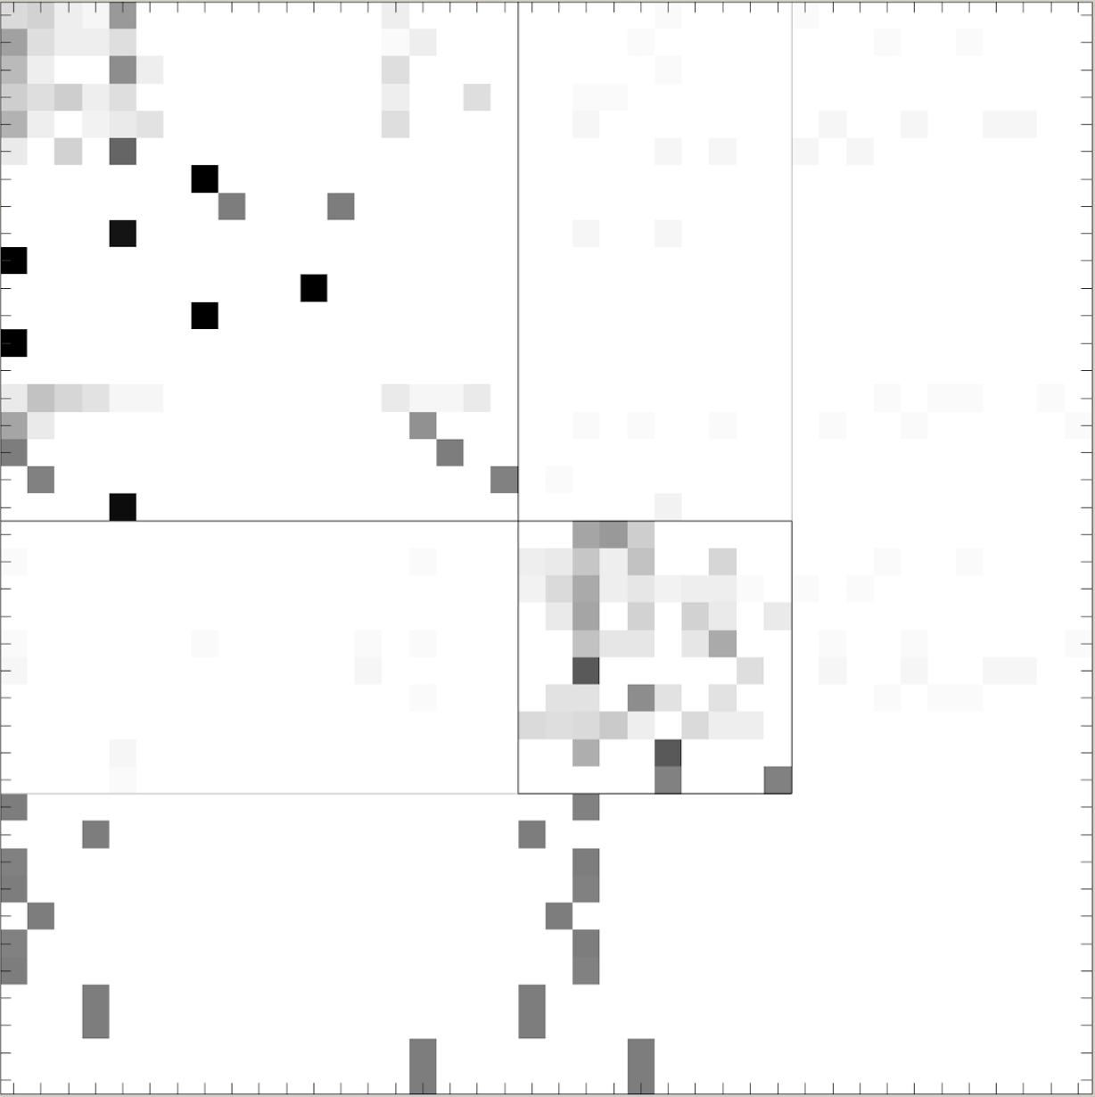
The CHAMELEON system
Learned
from
data
Produced by the system

Slide 63
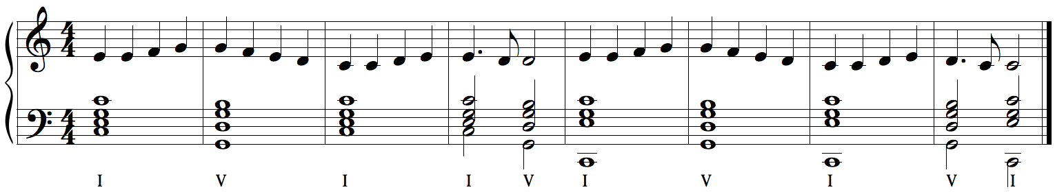
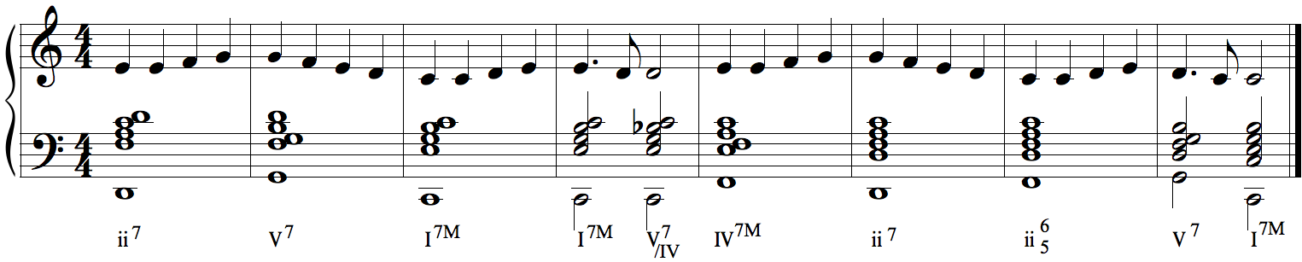
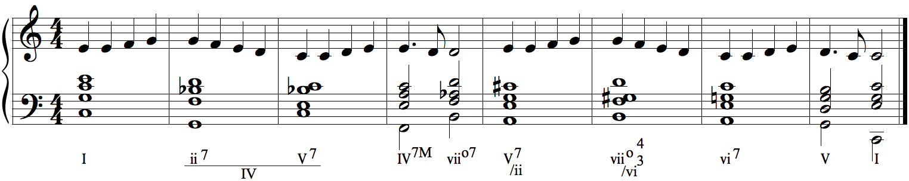
Blending Harmonic Spaces
L.v. Beethoven's "Ode to joy" with three harmonisations:
BC major (Bach chorale), JA major (Jazz), Blend of BC major/JA major

Slide 64
Ye Banks and Braes (Scottish)
G major space
(Bach chorales)
G major space blended with
B major space
G – Bb G – C#

Slide 65
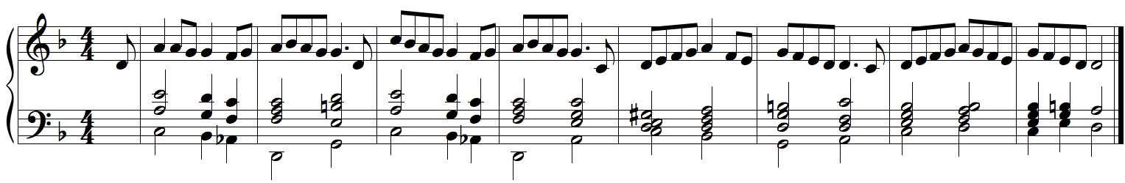
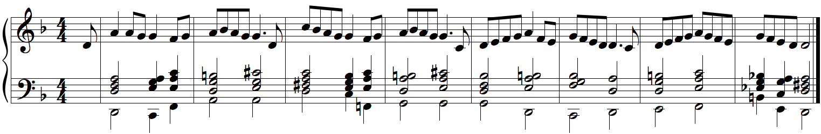
Blending Harmonic Spaces
The Greek folk song Apopse ta mesanychta (Tonight at midnight) with two harmonisations:
Blend of CN/WT and Blend of HM/JA minor
Apopse ta mesanychta – Constantinidis/whole-Tone blend
Apopse ta mesanychta – Hindemith/Jazz blend

Slide 66
Evaluating CHAMELEON:
Computational creativity evaluation is not trivial
Value (usefulness)
Novelty
Successfully meet the criteria of a specific task

Slide 67
Evaluating CHAMELEON: Experiments with students of the School of Music Studies
Passive Evaluation through listening
1. Experiments in harmony class:
Idiom classification, mode classification
2. Experiment in analysis/history class:
Type of chromaticism classification
Active evaluation through creative/compositional use
3. Creative harmonisation in stylistic composition class

Slide 68
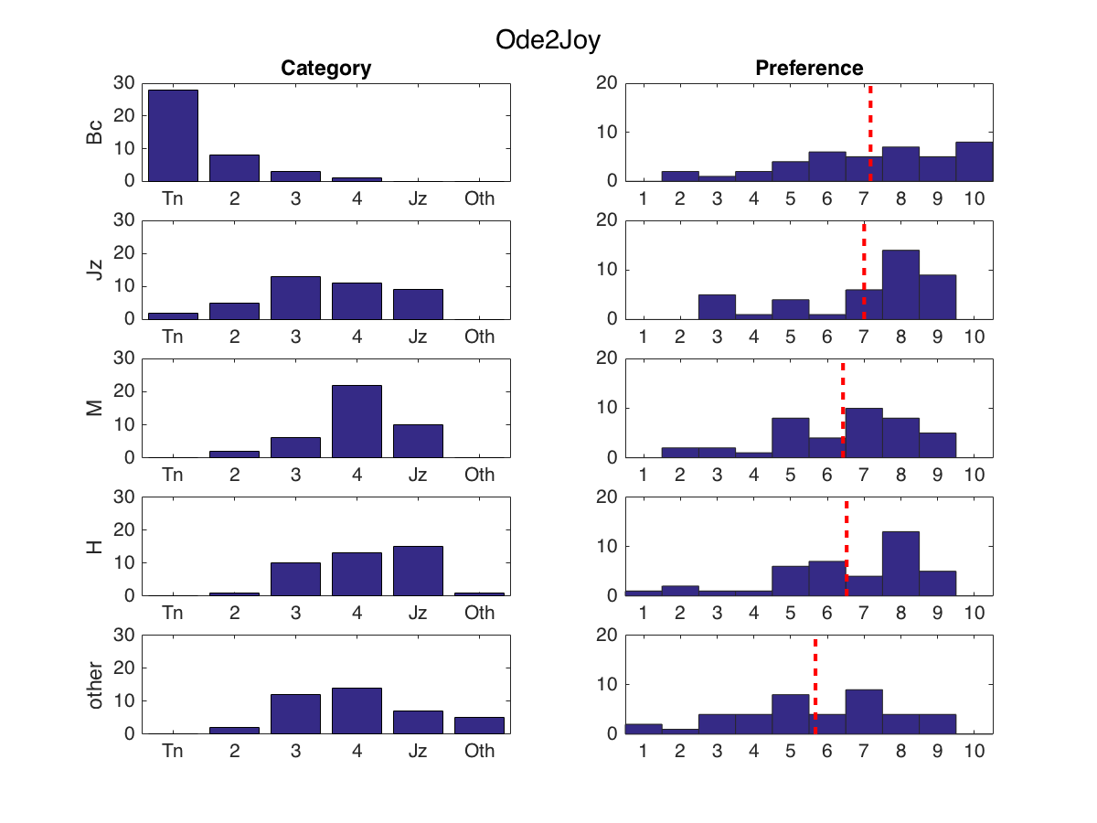
Results for "Ode to Joy"

Slide 69
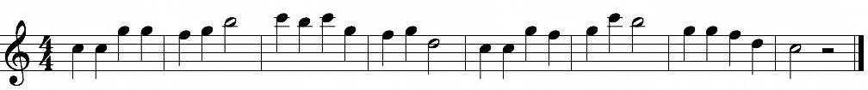
Mode classification
Melody used:
Custom-created melody intentionally lacking the 3rd and 6th melodic degrees, so as to avoid major-minor classification
Aim of experiment:
Assess the extent to which harmonic blending can affect perception of mode.
Assess preference (i.e., attributed aesthetic value)

Slide 70
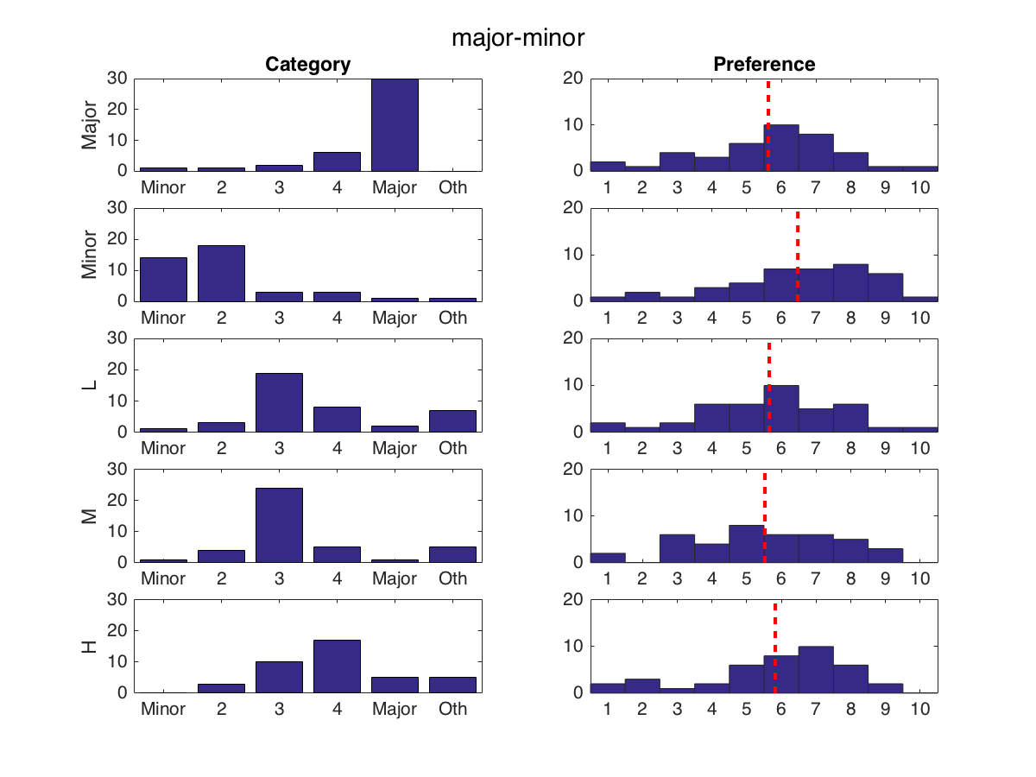
Results for "Major-Minor" melody

Slide 71
Type of chromaticism classification
Melody used for harmonisation:
"Ye banks and braes", Scottish folk song
Aim of experiment:
Assess the extent to which harmonic blending can affect perception of chromaticism.
Assess preference (i.e., attributed aesthetic value)
Assess expectancy (i.e., perceived novelty)

Slide 72
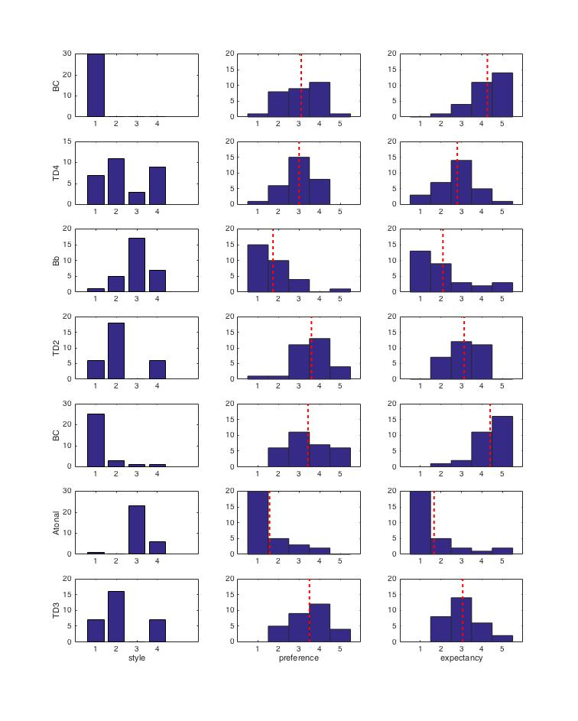
Results for "Ye banks and braes"

Slide 73
Enhancing human creativity (ongoing)
Ye banks and braes experiment
Students were assigned the task to harmonise the melody according to their taste.
Then they were given with system-produced harmonisations and were asked to decide if they would re-harmonise the melody.
Re-harmonised versions seem to be much more ‘interesting’.
Concert at the Museum of Contemporary Art
Composers were given traditional system-produced harmonisations of traditional Greek melodies and were asked to create musical works based on those.
The resulting works were performed by a professional piano player at a concert.
Initial comments by the composers are encouraging.

Slide 74
Expanding Conceptual Blending
Bonus part :/
Tackling the salience and the representation problems

Slide 75
Conceptual Blending
The Salience Problem
Example from the COINVENT project (2013-2016)
http://coinvent.uni-osnabrueck.de/
See also the CHAMELEON website:
http://ccm.web.auth.gr/blendedharmonisations.html

Slide 76
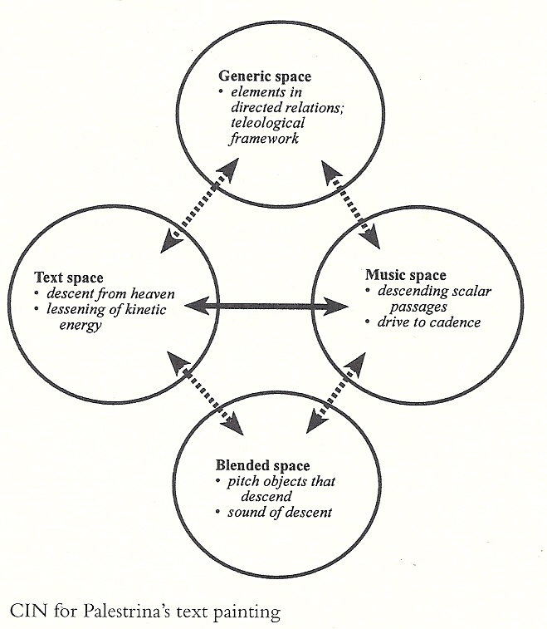
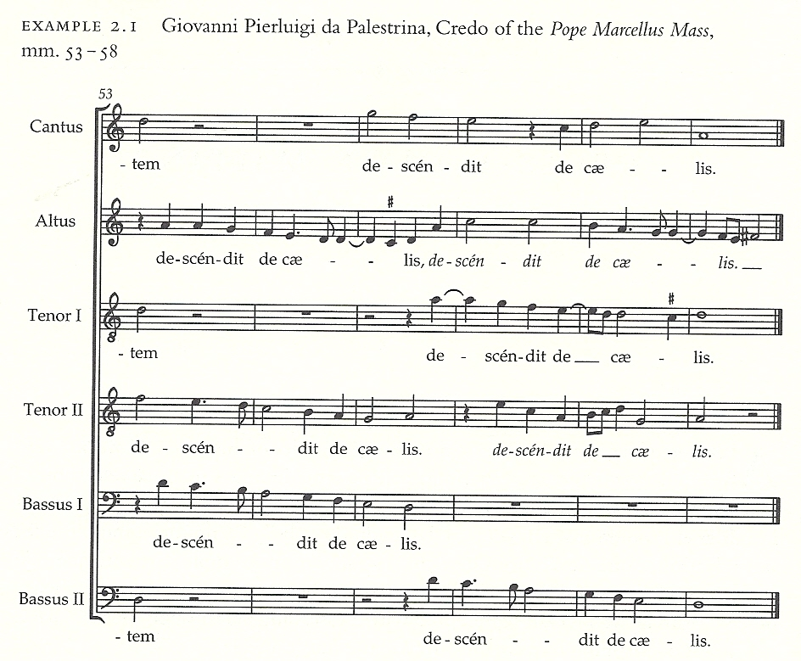
Conceptual Blending Theory (the first approach)
Fauconnier, G.,&Turner, M. (2003).The Way We Think: Conceptual Blending And The Mind’s Hidden Complexities. New York: Basic Books, reprint edition.
L. Zbikowski, Conceptualizing Music, 2002

Slide 77
Conceptual Blending
The Representation “Problem”
Example from the COINVENT project (2013-2016)
http://coinvent.uni-osnabrueck.de/
See also the CHAMELEON website:
http://ccm.web.auth.gr/blendedharmonisations.html

Slide 78
Conceptual Blending
Theory for Analysis
Development for generation
Cognitive theory
Based on category theory
Fauconier & Turner
Goguen
Method for explaining objects
Method for generating objects
Analysing creative “ideas”
Combining properties & relations
Depends on researcher’s intuition
Depends on representation
High-level representation
Low-level representation

Slide 79
Conceptual Blending
Theory for Analysis
Development for generation
Cognitive theory
Based on category theory
Fauconier & Turner
Goguen
Method for explaining objects
Method for generating objects
Analysing creative “ideas”
Combining properties & relations
Depends on researcher’s intuition
Depends on representation
High-level representation
Low-level representation

Slide 80
Conceptual Blending
Theory for Analysis
Development for generation
Cognitive theory
Based on category theory
Fauconier & Turner
Goguen
Method for explaining objects
Method for generating objects
Analysing creative “ideas”
Combining high-level features
Depends on researcher’s intuition
Depends on researcher’s intuition
High-level representation
High-level representation

Slide 81
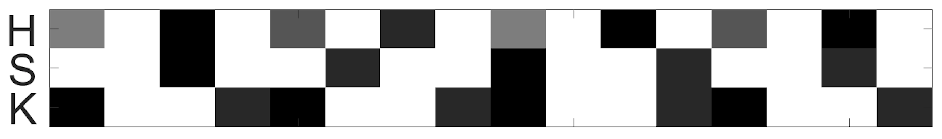


Conceptual Blending of Features
Example in drum rhythms
“Latin”
“Metal”
syncopated snare
dense kick
?
We need a “blend” with:
syncopated snare
dense kick
High-level Representation

Slide 82
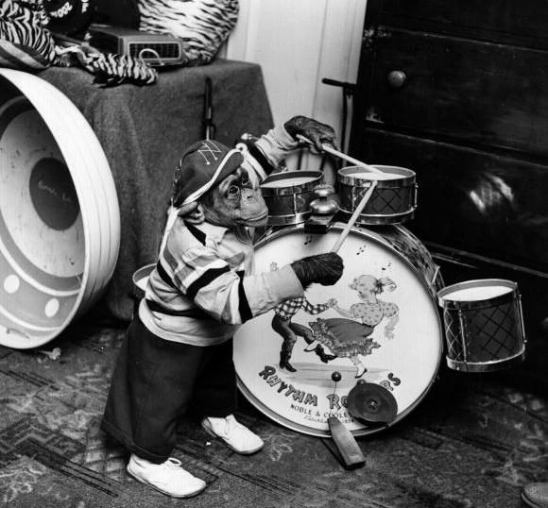
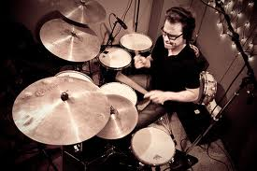
Conceptual Blending of Features
Example in drum rhythms
Step 1: By (somehow) blending features, we decided that:
We need a “blend” with:
syncopated snare
dense kick
…(40 features)
Step 2: Make a drum rhythm that incorporates these (target) features
Genetic Evolution

Slide 83


Conceptual Blending of Features
Example in drum rhythms
“Latin”
“Metal”
Possible “blend”
More examples at:
http://ccm.web.auth.gr/drumsblending.html

Slide 84
Conceptual Blending of Features: How?

Slide 85
Conceptual Blending of Features: How?
Input 1:
ftr 1: value11
ftr 2: value12
ftr 3: value13
.
.
.
Input 2:
ftr 1: value21
ftr 2: value22
ftr 3: value23
.
.
.
Blend:
ftr 1: value11
ftr 2: value22
ftr 3: value13
.
.
.
The blend must have the most salient features (later) of both inputs.

Slide 86
Conceptual Blending of Features: How?
Phenotype: 3 x N rhythm
N
Genotype: 1 x 3*N array
M. Kaliakatsos-Papakostas, A. Floros, and M. N. Vrahatis. Evodrummer: deriving rhythmic patterns through interactive genetic algorithms. In Proceedings of the EvoMUSART 2013 conference.

Slide 87
Conceptual Blending of Features: How?
Input 1:
ftr 1: value11
ftr 2: value12
ftr 3: value13
.
.
.
Input 2:
ftr 1: value21
ftr 2: value22
ftr 3: value23
.
.
.
Blend:
ftr 1: value11
ftr 2: value22
ftr 3: value13
.
.
.
The Salience Problem
We need to identify and blend
the most salient features.

Slide 88
Why blending salient features is important
Input 1 - shark:
ftr 1 – color: grey
ftr 2 – body shape: fishy & fin
Input 2 - zebra:
ftr 1 – color: zebra pattern
ftr 2 – body shape: horse-like
Blend:
ftr 1 – color: ?
ftr 2 – body shape: ?
Blend A:
ftr 1 – color: grey
ftr 2 – body shape: horse-like
Blend B:
ftr 1 – color: zebra pattern
ftr 2 – body shape: fishy & fin

